Slide 1
Revelation 17-18
Overview

Slide 2
Chapter 16 concludes the third and last vision of 7 in Revelation.
Now he is receiving the vision that summarizes and concludes all that John has seen earlier in the previous four scenes concerning the end.-p. 434-Brighton
The great prostitute or harlot-Greek word porneis.- She is the great enemy of the church on earth. First time she is mentioned this way in Revelation.
Who is this harlot? We have looked at this before, but we identify her with the second beast of Chapter 13. The beast personified or incarnate. She is the religious beast under the authority of Satan who gives power and authority to the second beast. In the culture of John’s day, it would have been the false religion of the Roman empire that would lead the government to persecute the Christians and deceive them. What we believe is implied by the fact that the harlot is riding the (first) beast in 17:3 implying control over the first beast. The beasts match up in details-17:7 & 13:1.
Read text note in Lutheran Study Bible. Look at 14:8-11

Slide 3
Why do we say this? Look at 17:7. She is said to be carried by the beast with 7 heads and 10 horns. This is the same way the first beast of Chapter 13 is described in 13:1. Plus, the blasphemous names tips it off. 17:3 and 13:1.
Remember she was called the false prophet in 16:13 and 19:20.
Read Brighton p. 436-437 through 1st paragraph.

Slide 4
Contrast between this woman, the harlot, and the woman of Chapter 12 who represents the church-Read Brighton p. 437. Look at Ezekiel 16. Also, in Proverbs Chapter 9, there is the difference between Lady Wisdom and Lady Folly.
Sits upon many waters-Read text note in Lutheran Study Bible.- In Jeremiah’s prophecy against Babylon he refers to Babylon as the city that resides upon many waters- (Jeremiah 51:13)
There were canals in the city because it sat on the river Euphrates and thus canals were constructed to bring the water to all parts of the city.
In this case, 17:15 identifies these waters as peoples, multitudes, nations, and languages.

Slide 5
The great prostitute or harlot is the religions of Rome and the institutions and clerics of those religions. Of course, Rome is surrounded literally by waters and the Roman Empire did have dominion over many peoples, nations, and languages at the time.

Slide 6
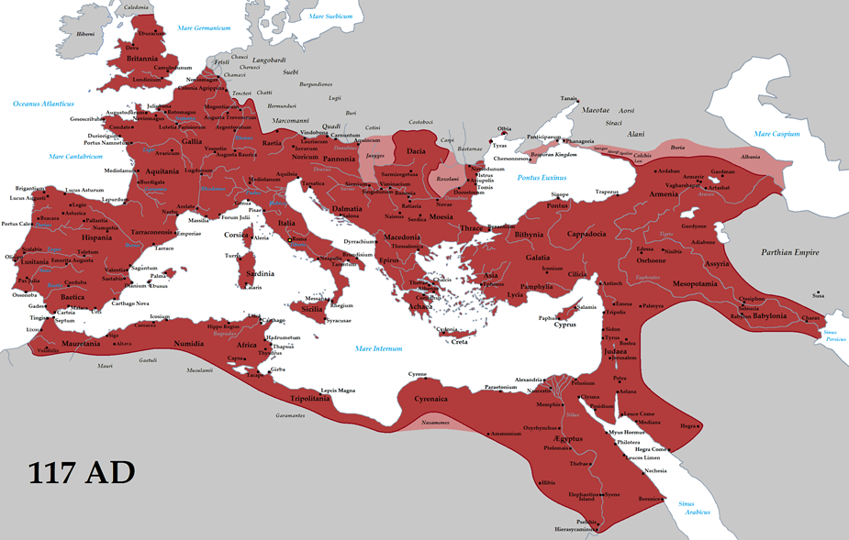

Slide 7
Rome makes sense as the fulfiller of this prophecy at the time because in v. 2, it says “with whom the kings of the earth have committed sexual immorality and with the wine of whose sexual immorality the dwellers of earth have become drunk.”
We know the Roman Empire was full of idolatry. I have read that the Roman Empire was about the most polytheistic empire to ever exist.
They had 12 major gods and a whole host of other minor gods.
Of course, all the world was influenced by this empire and committed adultery with her in adopting many of its beliefs and philosophies. They did this partly out of greed and trade. –Very similar to 14:8
The idea of idolatry as like committing adultery against God is found throughout the OT-Look at Brighton p. 436-Scripture references.

Slide 8
Clues to this great prostitute being the religious institutions that supported the Roman state.
She rides the beast- a scarlet beast-Scarlet was the color of the empire.
What color is associated with the Roman Empire? (Question asked the Internet)
“In Europe, since the time that the Roman emperors wore a Tyrian purple (purpura) toga praetexta, purple has been the color most associated with power and royalty.”-Wikipedia.org
2. Blasphemous names-idolatrous worship and emperor worship of the day-Read Brighton p. 441
3. Seven heads and ten horns-same way the beast is described in 13:1, and Satan is described in 12:3. 7 heads-denotes wisdom, deceptive wisdom, 10 horns-denotes power.
4. The woman too is arrayed in purple and scarlet and adorned with gold, jewels, and pearls. Proudly flaunting the cup full of her abominations and impurities-p. 442.

Slide 9
v.3-John- in the Spirit-3rd time in Revelation that John is caught in the Spirit-1:10, 4:2, 17:3, also 21:10.
Perhaps an experience like Ezekiel 8:3, or Paul-2 Corinthians 12:1-4.
Taken to the desert-Makes sense-the battle is in the desert or wilderness-The church, the woman of Rev. 12 was taken there (12:6, 14). Like Israel-redeemed and rescued and then brought into the wilderness. It is where the testing happened. The harlot attacks us as the church in the “desert or wilderness”-like Jesus.

Slide 10
v. 4-Abominations-Read Brighton p. 442. that which stinks, or that which is detestable. The word is used in the OT of the moral and ceremonial impurity connected with idolatrous practices. “Something disgusting that arouses wrath”-defined by BDAG. Only found in Luke 16:15, here in Revelation 17:4 and 21:27, and Matthew 24:15 and Mark 13:14. Found in Deut. 29:16.
She is called “Babylon, the great” in v. 5.
Marks her as the enemy of God’s people, just like Babylon was in the past. Causes all people to be led astray. The seat of wisdom-forehead.
Rome carries this name in Revelation-14:8, 16:19, 17:5, 18:2, 10, 21.-Chapter 18 depicts Rome’s Fall as “Babylon, the Great”

Slide 11
6. She is described as drunk with the blood of the saints, the blood of the martyrs of Jesus.-Clearly this describes the Roman Empire at the time. According to Tacitus, a Roman historian at the time of Emperor Nero, he talks about how the Nero’s gardens were thrown open for the execution of Christians for entertainment. He writes that some were crucified, some were sewn up in animal skins and hunted by dogs, and others were covered with pitch and set on fire.-F. F. Bruce p. 401.

Slide 12
Rome is a type of the future kingdom under the influence of Satan who will later rise against the church throughout the time of the NT. Rome will continually rise again in different forms (v. 8), but will ultimately be destroyed by Christ with His coming.
literally in the Greek, “the beast, the one who you saw was, and is not, and is about to rise out of the abyss and go away to destruction.” Hearkens back to 13:3 and verse 12 and 14. v.3-the head fatal wound, but healed-read text note in self-study Bible. Read Brighton p.353-354. Romans emperor Caligula who was terminally sick but miraculously recovered. Brighton text note. P.450.

Slide 13
v. 9-Greek word “sophia”
Rome known as the city of 7 hills, as many of her authors and poets proudly declared. Early Christian writers made the same designation. Clearly then referring to Rome.
7 mountains, represent 7 kings-Read Brighton p. 447-448. Then bottom of p. 449.
Now remember this all goes back to Daniel 7:2-3, 7-12-ten horns represent that it is exceedingly powerful. Most beasts only have two horns. The number 10 used in Daniel represents a number of quality that surpasses all others. Horns represent power.

Slide 14
v. 9-14-Clearly reveals the kings-the scarlet beast on which the great prostitute rides represents rulers or kingdoms who will rise up in the last days to make war on the Lamb (and His church), but the Lamb will conquer them (depicted in Rev. 19). It clearly shows the Lamb is the same as the one referred to in Revelation as the King of Kings and Lord of lords.
Lord of Lords, King of Kings-Depicted in 19:11-16-Psalm 2 and Psalm 110 and Daniel 7.

Slide 15
17:15-18-will be described at length in Chapter 18. Read Brighton on this-p. 454-455. The beast eventually turns on the harlot.
The harlot is made to be desolate-Interestingly, the great temples to the Roman gods and their religion are now in ruins. Some of them at the hands of the Roman emperors themselves-Look at next slide.
To be made desolate-to make something waste away or become arid or desert-like, or utterly ruined.

Slide 16
On the night of July 19, 64 A.D., a fire broke out among the shops lining the Circus Maximus, Rome’s mammoth chariot stadium. In a city of two million, there was nothing unusual about such a fire — the sweltering summer heat kindled conflagrations around Rome on a regular basis, particularly in the slums that covered much of the city.
Knowing this, Nero himself was miles away in the cooler coastal resort of Antium. Yet this was no ordinary fire. The flames raged for six days before coming under control; then the fire reignited and burned for another three. When the smoke cleared, 10 of Rome’s 14 districts were in ruin. The 800-year-old Temple of Jupiter Stator and the Atrium Vestae, the hearth of the Vestal Virgins, were gone. Two thirds of Rome had been destroyed.
History has blamed Nero for the disaster, implying that he started the fire so that he could bypass the senate and rebuild Rome to his liking. Much of what is known about the great fire of Rome comes from the aristocrat and historian Tacitus, who claimed that Nero watched Rome burn while merrily playing his fiddle. Gangs of thugs prevented citizens from fighting the fire with threats of torture, Tacitus wrote. There is some support for the theory that Nero leveled the city on purpose: the Domus Aurea, Nero’s majestic series of villas and pavilions set upon a landscaped park and a man-made lake, was built in the wake of the fire.
“It would have been seen as very inappropriate on the part of the elite in Rome,” says art historian Eric Varner. “They would have been happy if Nero had built the Domus Aurea out in the country, but to do it here in the city really was an extraordinary kind of statement.”
Tacitus was a member of this Roman elite, and whether there is a bias in his writing is difficult to know.-From the website-pbs.org-transcript of an episode that aired on PBS in 2002. Season 3, Episode 4 on “The Great Fire of Rome”.

Slide 17
Notice the Lord was behind the destruction. He made them to turn on each other. This in many ways happened with Nero and other Roman Emperors.
Will be fulfilled- or completed or finished-Jesus’ word from the cross.
Read History of the Fall of the Roman Empire- p. 192. Interesting right? Sounds like a warning!

Slide 18
“The quietly mounting pressure against paganism in the 4th century culminated in the decrees of Emperor Theodosius I (reigned 379–395), who made Catholic Christianity the official religion of the empire and who closed many pagan temples. By the end of the 4th century, therefore, Christianity had been transformed from a persecuted sect to the dominant faith of the empire, in the process becoming intertwined with the imperial government.”-From Britannica.com-”Relations between Christianity and the Roman government and the Hellenistic culture”.

Slide 19
Chapter 18
“After this, I saw”-typical signal of a new vision or section of the vision.
Describes now how the great harlot, Babylon, in this case Rome, will fall. We saw her start to crumble at the hands of those 10 kings in 17:15-18, now we are going to see her utter and complete destruction. Depiction from Ezekiel 23.
Chapters 17 and 18 are connected.

Slide 20
Could this angel of 18:1 be the same as the mighty angel of Chapter 10? Read Brighton p. 462-463. Also, read footnote in Brighton #18 on p. 463. Could be the angel referred to in 1:1 and 22:6 & 16. One with mighty authority.
A mighty voice-Read Brighton p.464-

Slide 21
Fallen, fallen is Babylon-Hearkens back to Isaiah 21:9, 47:1-15, Jeremiah 50-51. It is essentially John’s prophecy of what Jeremiah saw in Jeremiah 50-51. It will go the same way as the Babylon of old.
Babylon-the same as the harlot-14:8, 17:5.
A house or dwelling place for-Daimoniwn-demons-ultimately, Satan is always behind things that fall.
Fulakei-a prison or place of banishment-haunt-It could mean the prison to which demons and unclean spirits are banished by God-Word used in I Peter 3:19.
Detestable or hated-beast

Slide 22
What is meant by unclean birds and beasts, such as hated or detestable beasts-Could imply that it will be left a waste, so that only scavenger birds and beasts are left-Animals considered unclean in the OT-Goes along with the made desolate or a waste idea from Chapter 17:16.
Demons and unclean spirits-could imply that Babylon will be left with just the memories that haunt the empty shell of Babylon. Terrifying memories of the fallen, decaying corpses now haunt and eerily moan over the rotting corpse of the harlot herself. The demons and unclean spirits could be actual demons of hell that under the guidance of Satan-have been all along the companions of the harlot as they inspired her to carry out her anti-Christian activities. Now at her demise, having used her for their own devilish purposes, all that is left of the once proud city are the demons hovering over her corpse. You will literally see this image in Revelation 19:21.
Similar images to what is found in Isaiah 34:13-15; 13:21-22.
Also Jeremiah 49:12-13, 51-37-Look up.

Slide 23
v.3-Like in 14:10 or 16:19.-connects her as a prostitute-Jer. 51:7, Proverbs 5.
Like Israel did with the nations of old-Jer. 5:7-9, 13:26-27, Joel 1:5.
By the power of her luxurious sensuality-only time it occurs in the whole NT.
Merchants-sell and barter the antichristian message. All Antichristian propaganda and business.

Slide 24
There is the cry “Come out or Depart from her”-Imperative.
This is similar to the call that Isaiah and Jeremiah made to the people of Israel to come out from ancient Babylon, so that they would escape her destruction (Is. 48:20, Jer. 50:8, 51:6, 45). Also similar to Numbers 16:25-27. Or Jesus’ warning in Matthew 24:15-18.
“in order that you will not be a partner in her sins.”
It probably hearkening back to Jeremiah 51:6-11ff.-Look up.

Slide 25
You may not receive her plagues-word used frequently in Revelation-9:18, 20, 11:6, 13:3:12, 14, 15:1, 6, 8, 16:9, 21.
The seven bowls are described as seven plagues-15:1.
You don’t want God to remember your iniquities.
In contrast to the promise of the new covenant through Christ-Jeremiah 31:34- “For I will forgive their iniquity, and I will remember their sin no more.”-Also Colossians 2:13-14, 2 Corinth. 5:19,

Slide 26
About the double portion-Read text note. P. 467. Similar to Jeremiah 16:18. Mix her double-Read Lenski p. 520.
Also Jer. 25:14, 50:29, 51:24, 56, Psalm 137:8.
Habakkuk 2:15-16
v.6-luxious or wild living-word used in other contexts for bulls running wild.
Torment and mourning-Isaiah 47:8- Contrasted with what we will see for the saints in Revelation 21.

Slide 27
Sit as a queen-Is. 47:5-8, Zephaniah 2:15.
v.8-In a single day-The day of Christ’s return. The culmination of all things. It will not be a long drawn out punishment.
I Thessalonians 5:1-3. Remember Revelation 15:1.
Death and mourning-came with the first 3 plagues.
Fire-like the 4th plague-16:8, 17:16. Also, looking ahead to Revelation 19:20-21.
Jeremiah 50:32, 51:58.
Similar to Ezekiel 26 and 27-particularly 26:16.

Slide 28
Revelation 18:9-19-A lament or dirge over Fallen Babylon-Similar to Ezekiel 27:1-36. Read text note on p. 470- #43.
Kings weep and wail-weep and wail because they have been having her as prostitute. Their judgment has come with her. 6:15-, 16:14,
v. 10-Woe, woe-is a wail that voices the feeling of horror over a hopeless situation from which there is no escape. Like Ezekiel 16:23.

Slide 29
The last hour-I John 2:18, 2 Timothy 3:1, Hebrews 1:2, I Peter 1:20.
God has appointed a day, an hour for His judgment-Look at Isaiah 2:12-22
Merchants lament-warned about in James 5:1-3
About the merchandise-Read Brighton p. 472 middle paragraph.
Seafarers-Brighton p 475.
What is like this city? Like the cry in Ezekiel 27:32ff.
In one hour or moment-marks the suddenness and swiftness of the judgment.

Slide 30
v. 19-threw dust on their heads-Ezek. 27:30-31ff-Read Brighton p. 476.
v.20- The Greek word used there means more than rejoice or just be happy, but be joyful by having a celebration. It is a call for a celebration. A contrast to the dirge of the rest of the world.

Slide 31
v.21-8:5, Large millstone-p.479 in Brighton.
Rome completely destroyed. Music and everything silenced-like Ezekiel 26:13, Isaiah 24, especially v. 8. Jeremiah 25:1-11, contrast that with Chapter 19.
v.23- deceived by your sorcery- actually the word where we get pharmaceutical from- mixing of potions or occult type practices.
In this case, the sorcery was false signs and wonder-making that deceived the nations. People trusting in Rome more than God.
False signs of the 2nd beast or false prophet-13:13, 16:14.
The AntiChrist-2 Thess. 2:9-10

