Slide 1
Study of the Flood Account Genesis 6-9

Slide 2
One might ask: Why study the account of the Flood?
It happened so long ago. How is it relevant to my life today?

Slide 3
It is a valid question.
However, it can help answer questions related to
The age of the earth.
Global climates/geology/geography-the like.
The consequence and seriousness of sin, as the flood shows God’s serious view of sin, and as it points to Christ’s coming again.
Our relationship to the animals/creation today
Dinosaurs and their existence with man.

Slide 4
Read Genesis 6:1-4
God had told Adam and Eve to be fruitful and multiply. They were faithful to that command.
We know of 3 of their children for sure.
Cain 2. Abel 3. Seth.
Now we also know they must have had other offspring as well because Cain was worried about people finding him and killing him (Gen. 4:14). Which people? It has to be other offspring of Adam and Eve.
Also, it mentions that Cain knew his wife (Gen. 4:17). Adam and Eve must have also had girls unnamed in Scripture. Remember Adam lived 930 years, so if Eve lived to a similar age, it would have given them plenty of years to begin to populate the earth.

Slide 5
Genesis 6:1 speaks to this fact. They began to multiply or become many on the face of the land. This included daughters born to man. Notice prior to this it just focused on their male offspring. Now daughters are mentioned.
Genesis 6:2 is a bit of a mystery. Who are these sons of God? Three main interpretations:
1. Angels or demons, non-human, godlike beings. 2. sons of superior men, like kings or rulers. 3. sons of godly men, such as the descendants of Seth.

Slide 6
1. Angels or demons
Some have speculated angels because of the use of “sons of God” in other places of the Old Testament as a reference to angels: Job 1:6, 2:1, 38:7, Psalm 29:1, 89:6-7.
This is the oldest held view found in Jewish exegesis, like Philo and Josephus, and many early Christian writers (Justin Martyr, Irenaeus, Clement, Tertullian, Origen).
Also, they say this reference distinguishes them from the daughters “of man”, making them non-human.

Slide 7
However, we believe this would defy the nature and creation of angels, who were a separate creation from man. Jesus says in Matthew 22:30 that in the resurrection, we will neither marry or be given in marriage like the angels in heaven. It would be the fallen angels at best, demons possessing man, that could be the only way this reference would fit because the Lord would not permit such unions according to His will.

Slide 8
The royal interpretation was introduced into Jewish exegesis about the middle of the second century A.D., partly, it seems out of conviction that angels could not indulge in sexual intercourse and partly to suppress speculation about them (Wenham, p. 139-140). It became the most usual rabbinic view. This is partly because there are references to kings as “sons of God” in Psalm 82, 2 Sam. 7:14, Psalm 2:7.

Slide 9
Wenham-p. 140- “On this interpretation, the kings were guilty of an abuse by marrying “whoever they chose” i.e., compelling women to join their polygamous harems. It is urged that only an interpretation which identified “sons of God” with men as opposed to angels can explain why men are judged for the intermarriages that occur.”
However, this does seem pretty specific for this part of the narrative. It would seem that if Moses meant rulers or leaders, he would have mentioned that more clearly.

Slide 10
3. The Sethites is the view preferred by our theologians.
It is because it would fit the context to some degree. The Sethites, the descendants of Seth, were just mentioned in Chapter 5 and seem to be implied as godly men in the world. There is the reference in Genesis 4:26 after the mention of the birth of Seth and later his son Enosh that says, “at that time, people began to call upon the name of the Lord.” It would explain them being referred to as “sons of God” rather than “sons of man.” They perhaps reflected more the original image God had for man over against the other offspring of Adam and Eve. Such as the reference to Enoch in 5:22-24 walking with God.

Slide 11
However, like Adam and Eve before them, they became tempted by the attraction of “the daughters of men”, perhaps an allusion to Cain’s offspring and took them as wives against better judgment and it corrupted them. This was Luther’s opinion.
“The true meaning of the passage is that Moses designates as sons of God those people who had the promise of the blessed Seed (Gen. 3:15). It is a term of the New Testament and designates the believers, who call God Father and whom God, in turn, calls sons. The Flood came, not because the Cainite race had become corrupt, but because the race of the righteous who had believed God, obeyed His Word, and observed true worship had fallen into idolatry, disobedience of parents, sensual pleasures, and the practice of oppression.”-p. 12-Lectures on Genesis.

Slide 12
They were attracted or literally “saw as good”, the daughters of man. The reference to “saw as good” could be an allusion to Eve “seeing the fruit of the tree as good” (Gen. 3:6). Therefore, the line of Seth were corrupted and enticed into greater sin by their attraction and unions with the daughters “of man”, Cain’s offspring. They “took or seized” them as wives.
By the language, these were not viewed as holy, God-pleasing types of unions.

Slide 13
v. 3- “My Spirit”-Ruach-same word as Genesis 1:2. The active presence of God that gives life.
“shall not abide”-in other translations “shall not contend with, or strive with.”-Only time it occurs in the OT.
Prior to this, people were living 700 to 900 or more. Methuselah was 969 when he died. The Lord had said people would die, but he was letting them live too long given their increasing corruption and its influence in the world. They were living by His living-giving Spirit living in them, but God was losing patience with the corruption of their nature. Man after all is flesh. God has the right to decide our limits as fleshly man, now manifested after our own image, rather than his original image of righteousness and holiness.

Slide 14
Therefore, we believe this is the Lord limiting our years on earth to 120 years.
Some see this interpretation as problematic because we have people living beyond 120 after the flood.
Abraham (175), Isaac (180), Jacob (147), however as the Biblical narrative continues, the life spans decrease to no longer living beyond 120 years-Joseph (110), Moses (120), Joshua (110), only Aaron exceeds 120 (123).

Slide 15
Interestingly, according to Wikipedia, the oldest person when they died in recent, recorded history, was Jeanne Calmet from France, who died in 1997 supposedly at 122.
The next oldest died at 119.
The oldest known person today is Kane Tanaka, a woman living in Japan who is 118.
The oldest verified man when he died as a man from Japan at 116.
Interestingly, just on June 30th of this year, the Guinness World Record recognized a man from Puerto Rico as the oldest living man in the world at 112. He is almost 113.

Slide 16
Some commentators also see this 120 number as perhaps representing 120 year period of grace before the flood would come. If this was the case, it would give Noah 120 years to build the ark before the flood came. This would make Noah 480 at the time.

Slide 17
v. 4- “The Nephilim were on the earth in those days.”
Who are these Nephilim? They are only mentioned three times in the OT. Here and in Numbers 13:33, which references these very large people who were living in the land of Canaan when the spies checked out the Promised Land. They are called the “sons of Anak”. They are described like giants. Perhaps Goliath was from this line of people who was over 9 ft tall. Some see them as the offspring of these divine/human relationships described in v. 2.
Ultimately, they are a mystery.
Interestingly, this word is also found in Exodus 21:22 seeming to mean “miscarriages”. Could these be a sad byproduct of the sin in man causing defects leading to very large humans? Good question.

Slide 18
The text seems to imply that these Nephilim were around in the days of these unions between the sons of God and the daughters of man or were a result of this union. The Lutheran Study Bible associates these with tyrants or thugs.
Regardless, these offspring were viewed as mighty men, or warriors-Gen. 10:8-9, Ezek. 32:21, 27. Manly men, champions, men of war-termed used of Goliath-I Sam. 17:51, men of war- I Samuel 14:52.
“men of renown”-They were known, had fame.
Men of name-

Slide 19
Lutheran Study Bible text note
“First nobility of the world was a group of tyrants, who were admired nonetheless. They were sinners ripe for judgment in God’s eyes.”
Concordia Study Bible note
“The Hebrew word means “fallen ones”. In men’s eyes, they were ‘the heroes of old, men of renown’, but in God’s eyes they were sinners (fallen ones) ripe for judgment.”

Slide 20
v. 5- “the Lord saw”-It is interesting. Prior to this, when it says the Lord saw, it was always in the context of Him seeing something good.
Used in 1:4, 1:10, 1:12, 1:18, 1:21, 1:25, 1:31.
“the Lord saw it was good”
Now it says, “the Lord saw”, the great wickedness of man. He saw that great the wickedness of man on or in the earth.
The word wickedness can be also be translated in other contexts, “evil or harm or crime”.

Slide 21
In fact, it was so bad, it says the thoughts or intentions of the thoughts of the heart were only evil or bad or depraved, all the time.
It is how bad things had gotten in the Lord’s good world that he had created. A complete contrast to what it was like before the Fall.
v. 6- “The Lord was sorry or regretted”-
“grieved to his heart”-Interestingly, this word grieved was used earlier in Genesis 3:16 in reference to “in pain, you will bring forth children.” The Lord’s grief over the wickedness of man was on par with a woman’s pains in childbirth.
Paul draws on the image of pain in childbirth in Romans 8:22 when describing what all of creation is feeling as the results of the Fall of man.

Slide 22
Wenham says, “the root for grieved or pained is used to express the most intense form of human emotion, a mixture of rage and bitter anguish.”-p. 144.
It was how Dinah’s brother felt after she was raped (Gen. 34:7) or how Jonathon felt when he heard about the plan to kill David (I Sam. 20:34), or how David reacted when he heard about the death of his son Absalom (2 Sam. 19:3).

Slide 23
v. 7-His grief and sorrow over how far man had fallen into evil led him to decide he must cleanse his earth.
“Wipe out, blot out”-used to erase names from records or plates-Wenham p. 145.
Moses’ language included all the living creatures made by God.
Adam
Animals-Behemah-Gen. 1:24-25
Creeping things-Gen. 1:21, 24-25
Birds-Gen. 1:20ff

Slide 24
Now why was all of creation punished with man?
They were originally created for the use of mankind, they share in the consequences of man’s evil.
The Lord, we think, takes the life of an animal to clothe man.
The ground is cursed as a result of their sin-3:17-18.
There is an interconnectivity between us and the rest of God’s creation.

Slide 25
In a document called, “Together with All Creatures”, a CTCR document of our church body it says, “What is surprising is that human evil provoked God to judgment, yet God not only expresses regret that He made the humans, but that He had also made the animals, birds, and creeping things! Its startling because they had not “sinned”. By speaking in this way, the text highlights the interconnection of all God’s creatures. We are all in this together. God does not deal with humans in isolation from His nonhuman creatures. He considers all of His creatures to be part of a single creation. God’s human creatures and nonhuman creatures now share a common fate, namely, the undoing of creation.”-p. 35

Slide 26
However, all of creation is also waiting for its future redemption, to finally be free from sin and its bondage and effects. It is what we believe Paul is saying in Romans 8:19-23.
It is why the new heaven and the new earth described in Revelation 21/22 seems to depict a return to the original intent of creation. The tree(s) of life return, the river of life running through it. Will there be animals in heaven? It is a good question. Christ is depicted riding on a white horse, probably figurative. The rest of creation was saved through the flood along with man, why not in the new creation?

Slide 27
v. 8- “But Noah found favor in the eyes of the Lord.”
The name Noah is interesting. Look at 5:29 as to why he was named as Noah.
Noah seems to mean, “relief or comfort.” Interestingly, the Hebrew word for sorry or regret can mean in other contexts “comfort or relief”. Noah comes from that Hebrew word used in 5:29 and 6:6. .
There are connections between 5:29 and 6:5-7.
The ground was cursed because of Adam, bringing pain, Noah would be used to bring relief or comfort.
Noah-in many ways, a type for Christ.

Slide 28
The word for “Favor” means a formal expression often used when someone in authority helps someone without status. It could also be translated grace. Basically, the Hebrew equivalent of the concept of grace. A favorable view by another.
It is rare in Scripture for someone to be referred to in this way. Moses is another example (Ex. 33:17).
In the eyes-a contrast to Adam and Eve seeing and sinning-Gen. 3:5-7. They saw with their eyes. It looked good. They ate.
God now sees with his eyes a man who finds favor in his sight.

Slide 29
v. 9-Noah is described in three important ways.
Righteous-first occurrence of this word in the Scriptures. This term is meant to be in contrast to wickedness or evil. Used 206 times in the OT, usually in Psalms and Proverbs.
In legal contexts, it means ‘innocent’ or ‘acquitted’ of specific offenses. More generally, it is used in reference to someone who keeps the moral law and tries to avoid sin. Compared to the rest of Noah’s generation he is righteous.

Slide 30
blameless-could be translated “unobjectionable, not easily blamed, sound, practically perfect in comparison.”
The blameless are characterized by:
By their abstaining from iniquity
Walking in the Torah or Law of Yahweh (Psalm 119:1)
Others described this way-Job, Abraham, All of Israel was told to be blameless (Deut. 18:13).

Slide 31
With God, Noah walked.
A way of saying, he walked in faith and in righteous obedience to the Lord’s ways.
Walking-an intentional action. To follow in one’s footsteps. He worshiped the Lord.
Remember the curse upon the serpent was no longer walking.
In contrast, Enoch walked with God-5:22. It was always God intention for us to walk with Him literally in perfect communion.
This does not mean Noah was perfect, but as close to God’s original intention for man as one could post-Fall.

Slide 32
v. 10-Three sons: Shem, Ham, Japheth.
Shem-means, “named one”-also Hebrew word for name.
Ham-husband’s father, like father-in-law.
Japheth-seems to be connected with the Hebrew word for “beautiful or attractive.”.
No special significance to these names that we know of.

Slide 33
v. 11-the earth was corrupt or spoiled or polluted.
First time this word is used in OT.
“violence or harm”-First time this word is used in OT.
It is how bad things had become in the world. Who would want to live in a world like that?
v. 12-”And God saw” again-No longer good.
The exact opposite.
Corrupted their way-actively living contrary to God’s law and will.

Slide 34
v. 13-Imagine getting this news from the Lord.
Interestingly, the Lord uses the same word for “corrupt or spoil”, to described what he is going to do man.
They destroyed or spoiled his good creation, the earth. Now, behold, he is going to destroy them from the earth.

Slide 35
v. 14-Make yourself an ark of gopher wood.
The word “ark” is only found here in and Exodus 2:3, 5 for the “ark” or basket of bulrushes that Moses was put in as a baby.
Both of them were made to preserve life.
From one of the signs at the Ark Encounter it says, “Many Hebrew lexicons state that teyvah is likely derived from the Egyptian word for sarcophagus. If this is accurate, what would sarcophagus, a container for the dead, have to do with preserving life? A reasonable solution is that ancient Egyptians believed a sarcophagus preserved a person for the afterlife.”
Remember Moses is writing this. He is trying to describe in human terms something really beyond words. It was more than a boat, but a really big life raft.

Slide 36
Gopher wood-Word only occurs here in the Scriptures.
From one of the Creation Museum signs, “Some Bible versions translate the term for gopher wood as cypress, and cedar has also been mentioned as a possible choice. However, these guesses are largely based on the mistaken notion that Noah built the Ark in the Middle East. Prior to the Flood, the earth was very different, and there is no way for us to know where Noah built the ark. Ultimately, we cannot positively identify gopher wood today.”

Slide 37
v. 14-Make rooms or compartments or nests (some contexts) in the ark.
“Cover it inside and outside with pitch.”
From Creation Museum sign, “The source of the pitch for Noah’s Ark is not known. It could have been bitumen or gums extracted from plant resins. The process of manufacturing pitch from pine resin has ancient origins. Wooden ships were waterproofed by pitch from tree resins well before the oil industry was born. The core ingredient of plant resin is gum resin.”

Slide 38
v. 15-Dimensions of the Ark-in length, 300 cubits, its breadth-50 cubits, height-30 cubits.
What was a cubit? A common measurement used by a number of ancient cultures. It was equal to the distance between a person’s elbow and the tip of their longest finger.
They were not consistent between ancient cultures. It was roughly around 18 inches. The Ark Encounter argues that many ancient construction projects were built using the royal cubit, which adds the width of four fingers (approx. 3 inches) to the standard cubit. They estimated that to be 20.4 inches. This is what they used as their measurement to recreate the Ark at the Ark Encounter.
Therefore it would equal roughly 150 yards in length, 25 yards in breadth, and 15 yards in height.

Slide 39
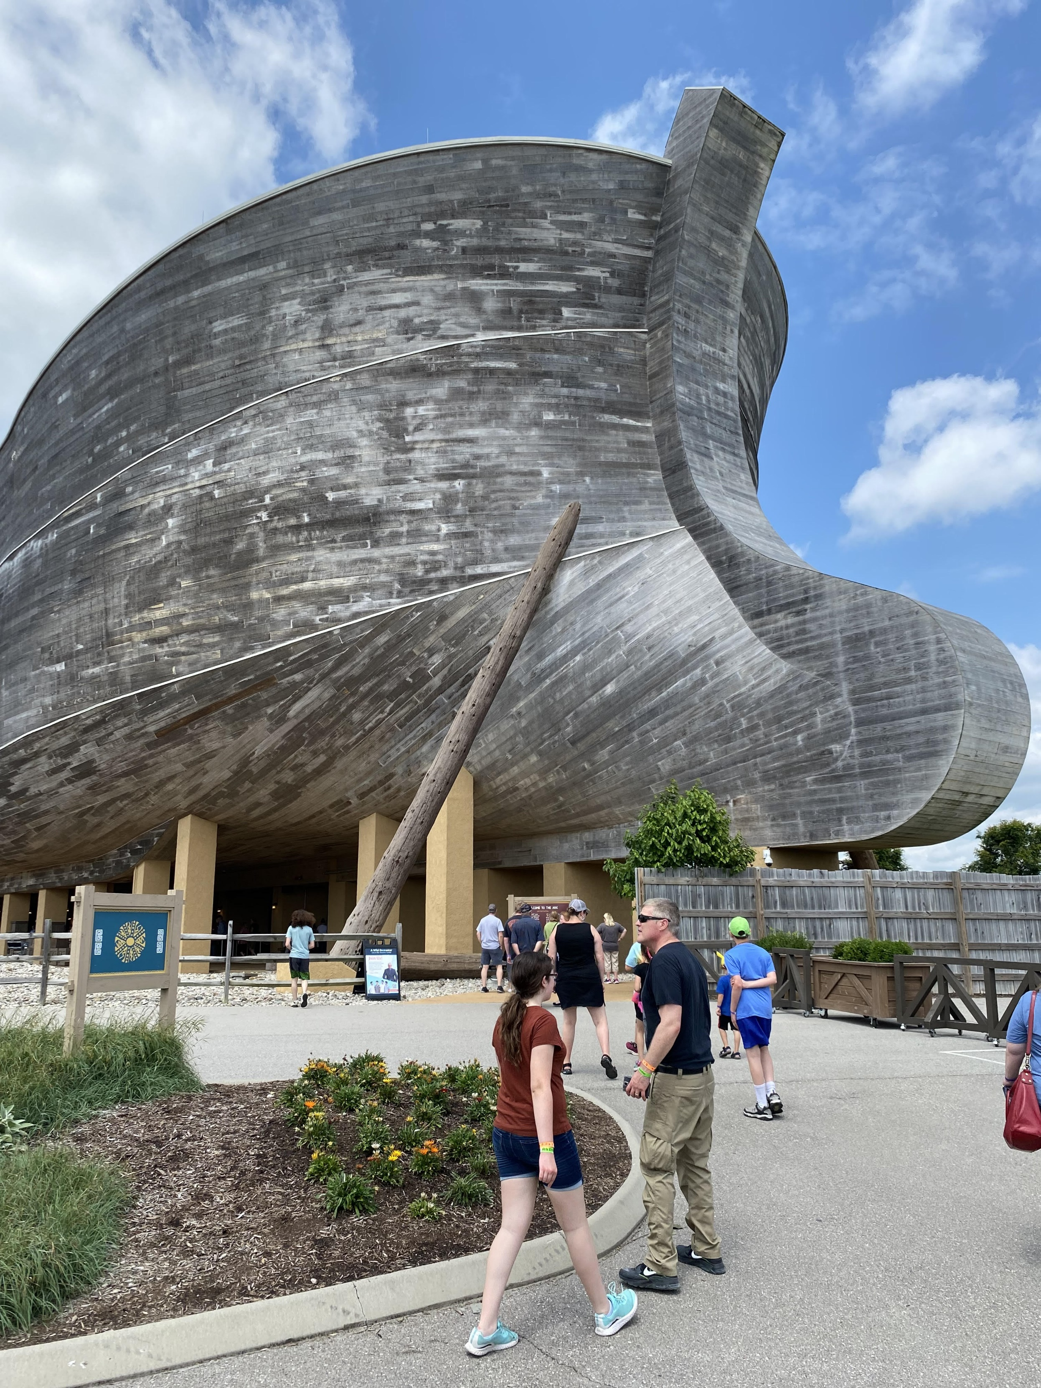
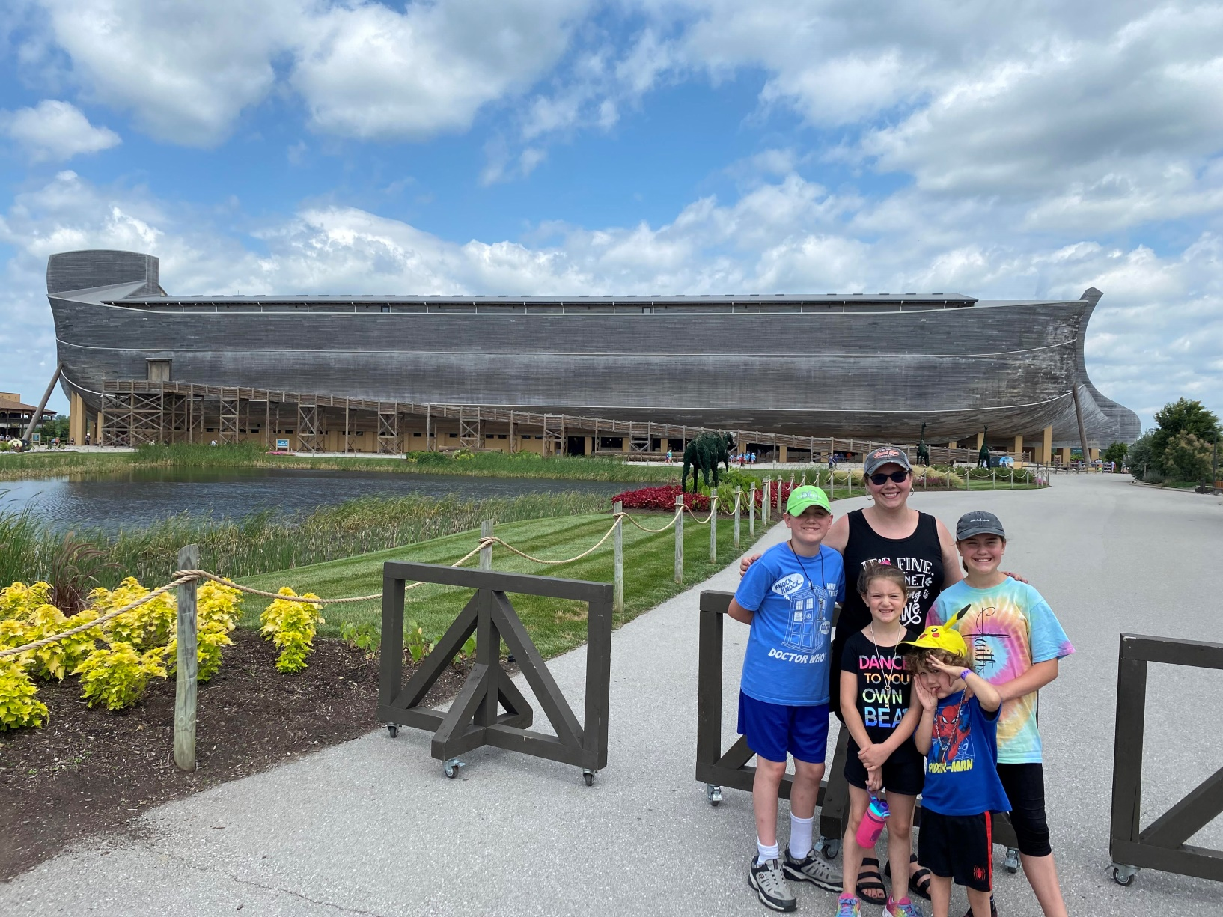
He was to put a roof on it, place a door on the side, and make three decks.

Slide 41
v. 17-and I, behold-In the Hebrew, this is always alerting big, important, noteworthy news.
“I will bring a flood or deluge of water upon the earth”
To wipe out or destroy-same word used in 6:11-12ff
“all flesh which in it (has) the Spirit (Ruach) of life under heaven. Everything that is on the earth will die.”
Die-will expire, breathe one’s last.
The Spirit-goes back to v. 3-God put His Spirit of life in us and all, except Noah and his family, would die by the flood.

Slide 42
There is some speculation as far as whether it had rained before this on the earth. Some speculate that the weather might have been quite different prior to the flood. It is because of the reference in Genesis 2:5-6. Now this reference I don’t think implies that there was never any rain on the earth, but that it had not yet rained prior to God’s creation of man. God rather sent a mist or spring to go up from the earth and it watered the ground. However, had there been a flood prior to this caused by the rain? Probably not, although who knows.
It does seem to make the special point that “behold, God will send a deluge of water…”

Slide 43
v. 18-”But I will establish a covenant with you.”
This is the first instance in the Old Testament of the Hebrew word for covenant, meaning a will or agreement.
An agreement or establishing of oaths or obligations between two parties, almost like a treaty, that would seal a relationship with promises of blessing for keeping the covenant and curses for breaking it.
It is a word that literally means “to cut”, as it was typically sealed with a sacrifice.
God is establishing the covenant.

Slide 44
The obligation on the part of Noah is to enter the ark with his family.
v. 19-Also, of every living thing of all flesh. It defines that animals are included in those with flesh.
Two of all, a male and a female.
v. 20-the birds-Gen. 1:20, 6:7,
According to their kinds or species-Gen. 1:11, 12, 21, 24, 25
The animals-Behemah-Gen. 1:14-25, Gen. 6:7
Creeping things-Gen. 1:21. 24-26, 6:7. (like small animals, reptiles).
Two of each-to preserve them or keep them alive

Slide 45
v. 21-every food-Gen. 2:9, food from plants or trees-all vegetarians at this point.
Serve as food for you and them.
v. 22-Noah did it all as God commanded-He would keep his part of the covenant.
How did they fit them all?

Slide 46
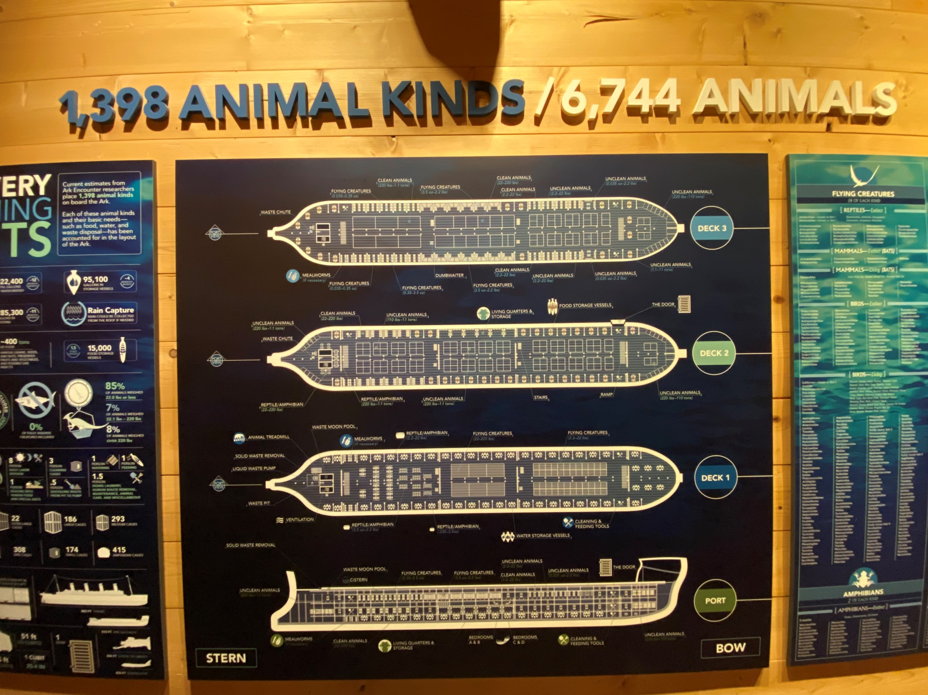

Slide 47
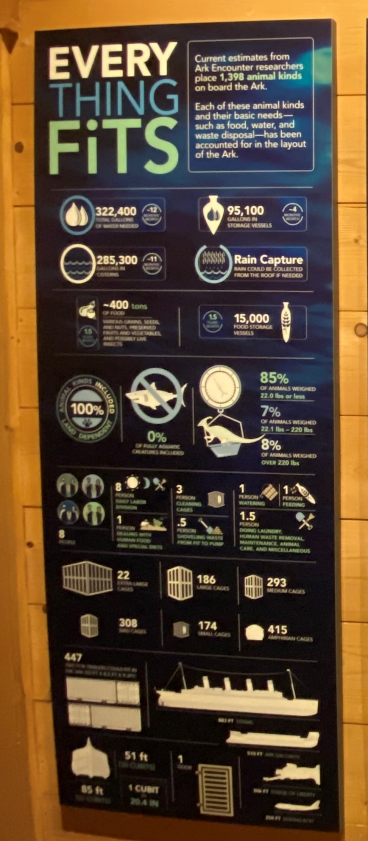
Ark Signs p. 9
According to their kinds-An animal kind or baramin (from the Hebrew words for created and kind) is a group of related animals not related to any other animals. The study of created kinds is called baraminology. Studies that began in 2012 estimate that among land-dependent vertebrates there are fewer than 1,400 known living and extinct kinds.

Slide 48
It is estimated that there are fewer than 34,000 species of known, land-dependent vertebrates in the world today.

Slide 49
How did just those few kinds become the variety of animals we see today?
Of course, Evolutionists say that this could only happen after millions and billions of years due to small genetic changes, as they believe one kind could turn into another kind.

Slide 50
From the website, livescience.com

Slide 51
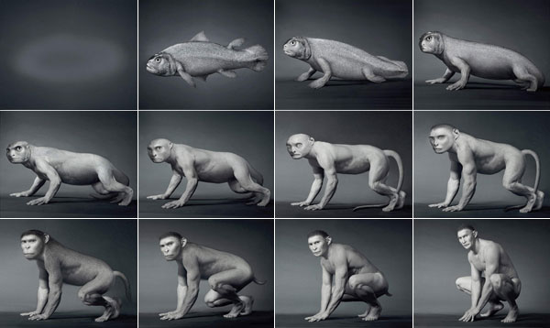
Another depiction of evolution

Slide 52
What must be established is the difference between macro-evolution and micro-evolution.
We can see genetic mutations and changes within species.
Lions/Tigers-Ligers
Variety of dog kinds
Zebras/Donkeys-Zonkeys
Zebras/Horse-Zorse
There can be cross breeding within species.
Viruses change, Changes seasonally.

Slide 53
Read p. 33 in Ark Book.
God gave the animals the ability to adapt and change for the sake of survival in a post-Flood world.
You can clone and cross breed within species, but they have not been successful between species. There has to be a certain amount of genetic similarities.

Slide 54
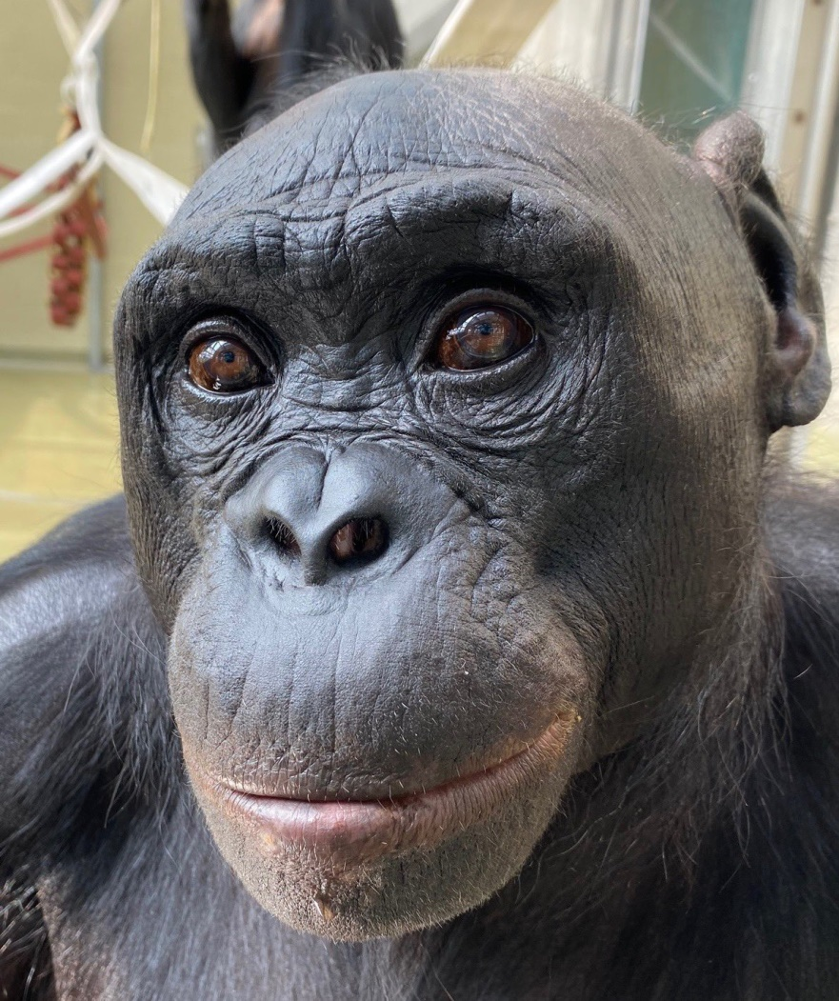
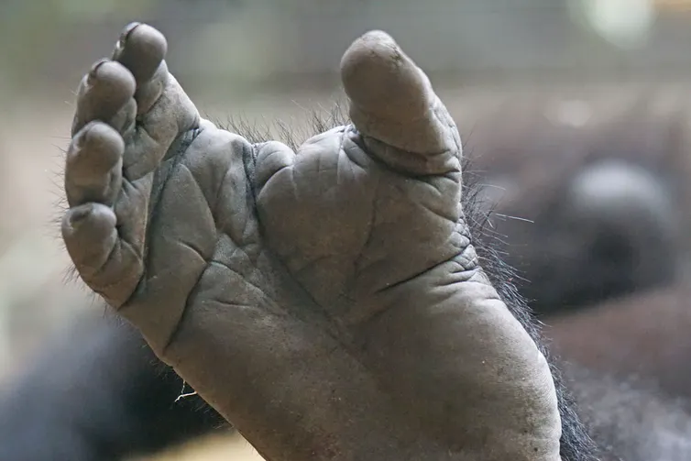
Like for instance, they say we came from apes. However, the Bible tells us we are a distinct creation of the Lord apart from apes. There are key differences.

Slide 55
v.21-God makes it very clear Noah is to take every sort of food on the Ark for food for them. Same word found in Genesis 1:29-30 where the Lord gives them the command to eat from the trees and plants for their food.
How did they feed and care for all these animals however?
Some depictions: Ark Book p. 38-39, 40-41
Water and Waste- p. 46-47
Ventilation- p. 42-43
Lighting-p. 44-45

Slide 58
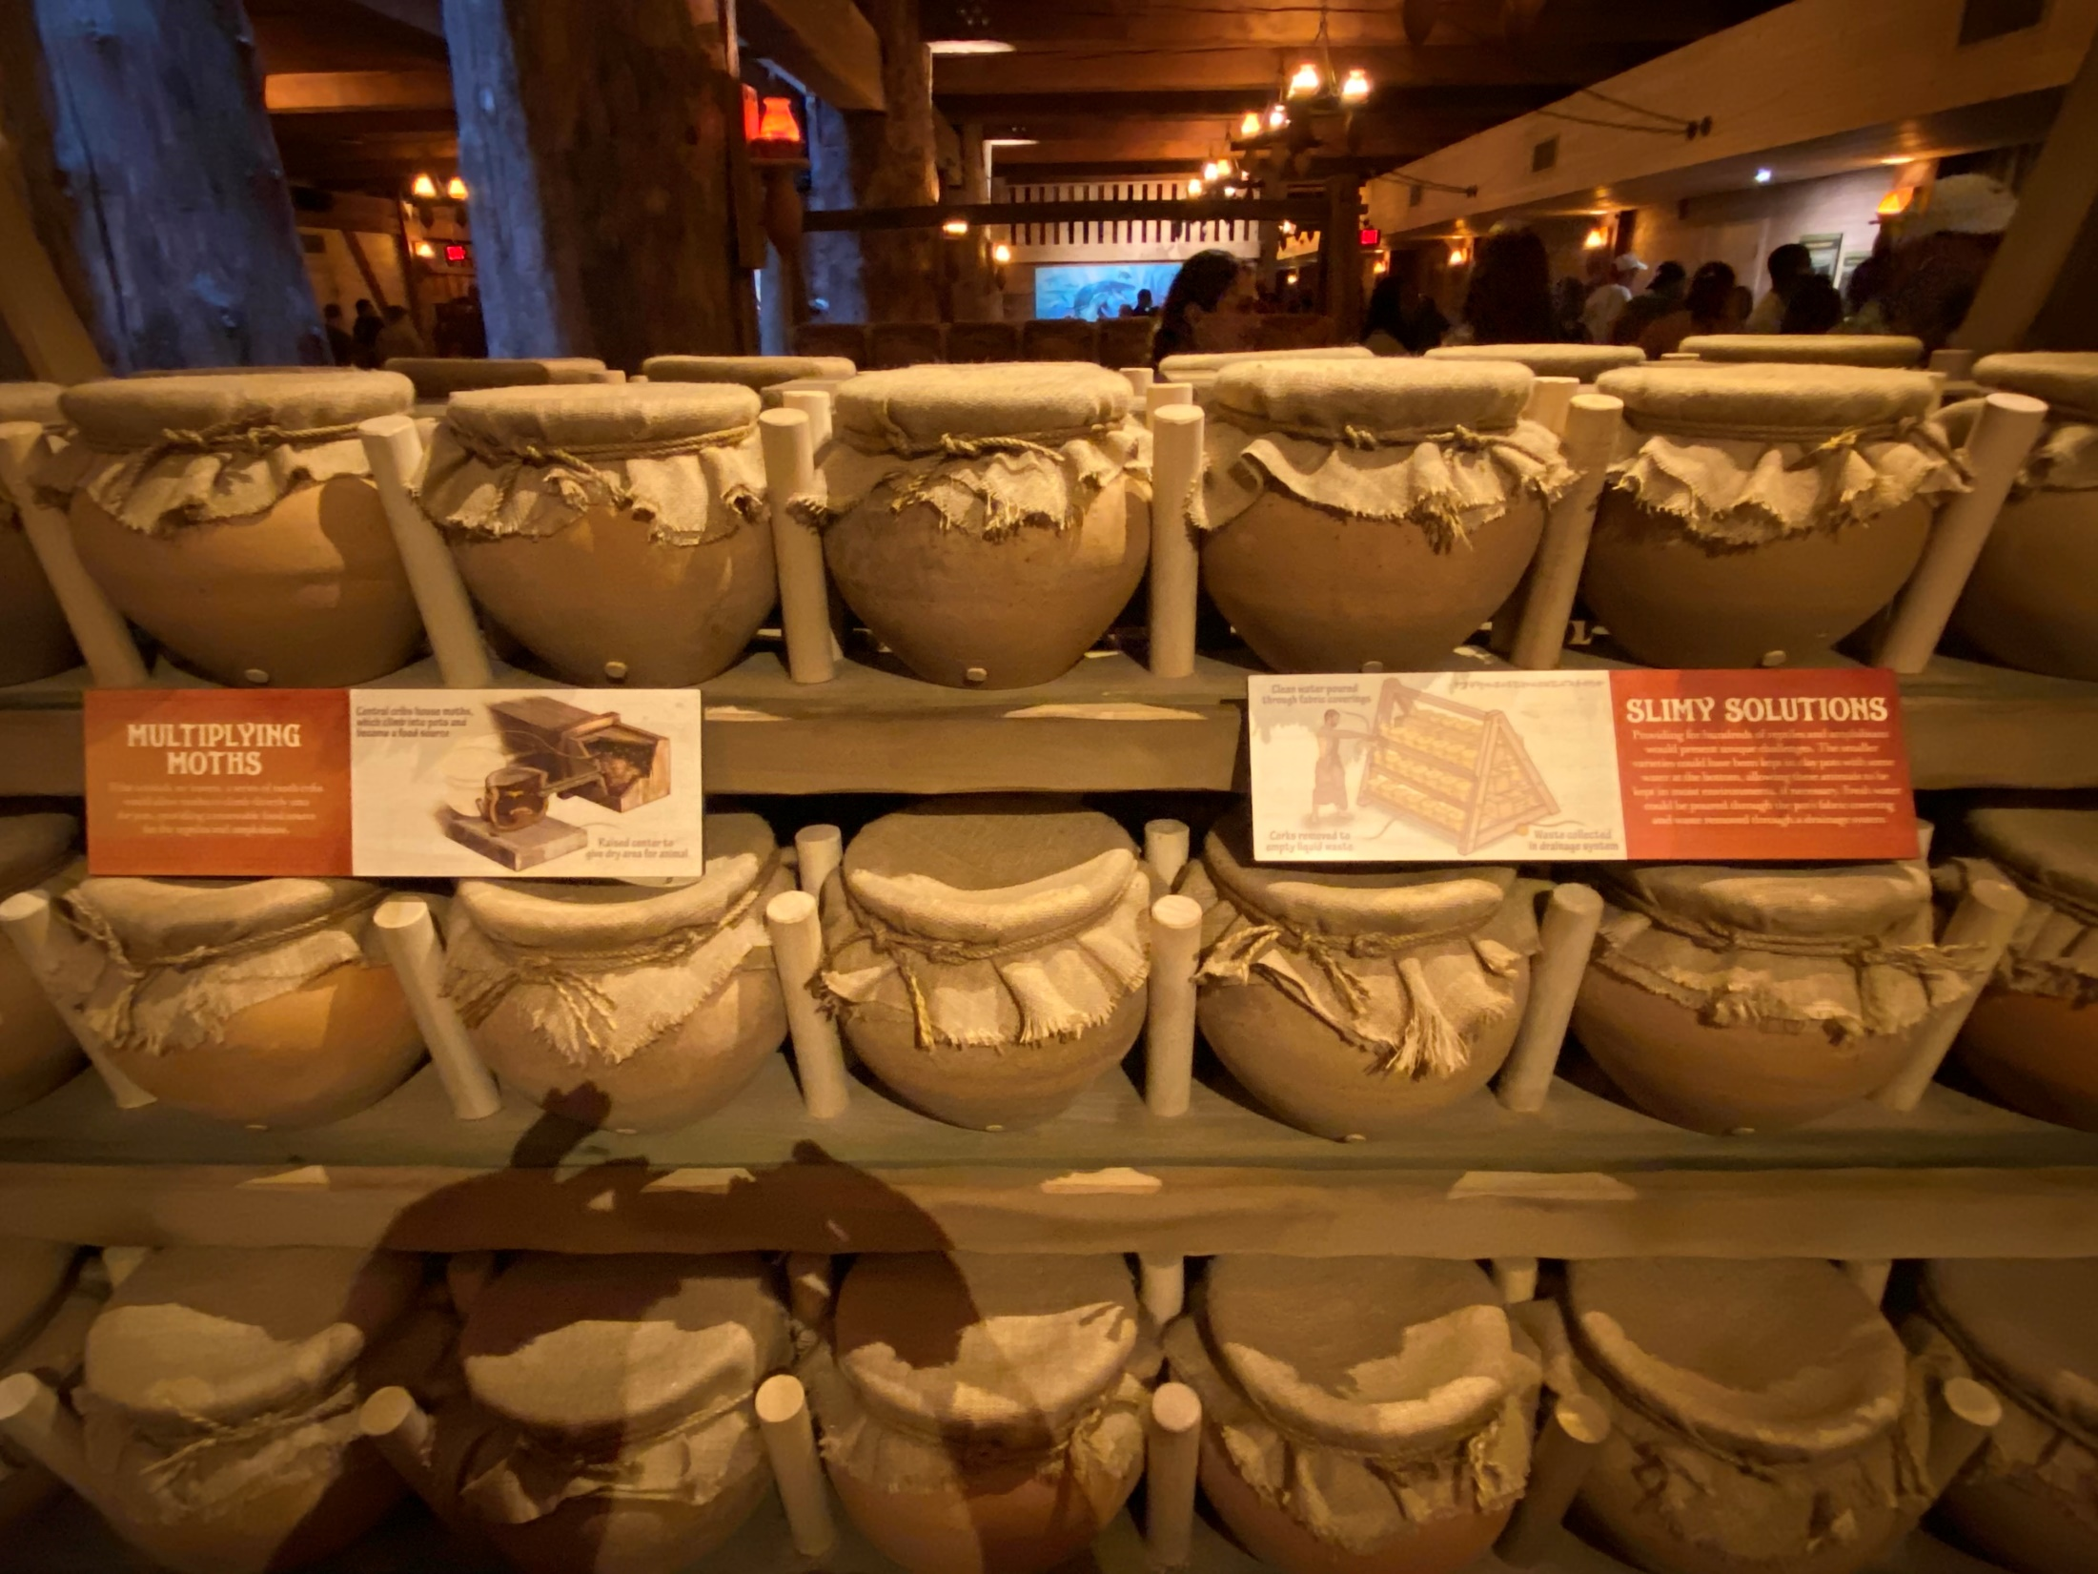

Slide 59
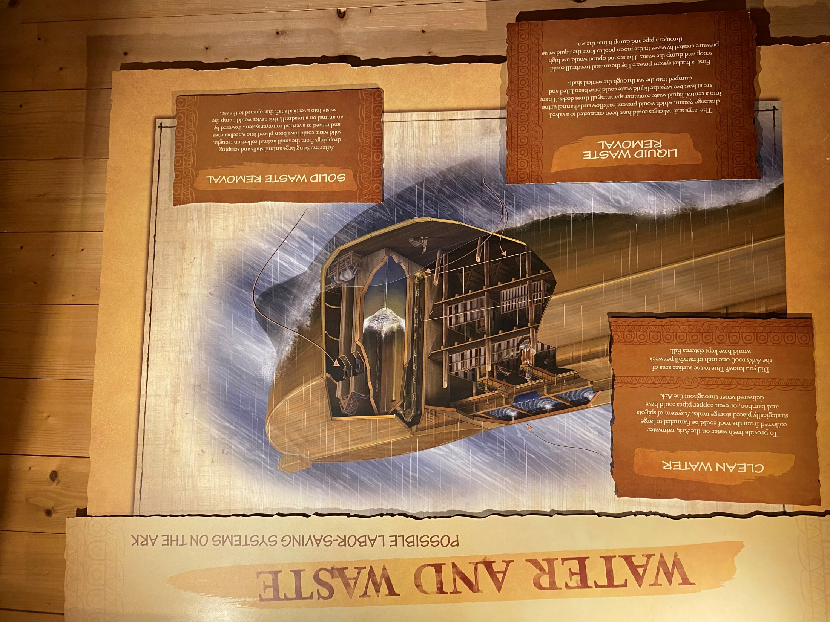

Slide 62
Chapter 7
Read Chapter 7:1-5
v. 1-The Lord emphases again that Noah and his family are being spared because they were righteous before him-repeating 6:9.
v. 2-3-He tells them to take 7 pairs of the clean animals, male and female and just a pair of the unclean animals.
This is the first mention in the Bible of the distinction between something being clean or unclean, using the Hebrew word for clean.

Slide 63
Now had this distinction existed from the time of creation or was this now a distinction the Lord is teaching Noah for the first time? It is a good question.
Whether it existed before is not terribly relevant, but now the Lord must have taught Noah this distinction. Now on what was this distinction based?

Slide 64
Well, the only thing we can go on is the distinction between clean and unclean animals that the Lord later gives to Moses in the Levitical Law. In Leviticus 11, the Lord gives the clear instructions to Moses and Aaron and his sons as to which animals were considered clean and which ones were unclean. For land animals, they had to meet two criteria, with a few exceptions.
They had to be cud-chewing animals (like sheep, goats, cattle, etc.)
Had to have split hooves

Slide 65
They exceptions given to that rule were: the camel, rock badger, hare, and pig.
The camel, rock badger, and hare chew the cud, but does not part the hoof.
The pig has parted hooves, but does not chew the cud.
Now what might be the differences between these animals? I don’t know if we can say there is a hard and fast rule, but in general, the land animals considered clean, such as sheep, goats, and cows chew cud because they eat primarily grass or grains. They would be healthier animals to eat from than animals known to scavenge and perhaps eat other animals or dead animals.

Slide 66
I know camel’s today are known to scavenge and eat about anything. In April 2021, I read an article about 300 camels that died in the Middle East because researchers determined they ate too much trash. They found 2,000 plastic bags in the stomach of a camel.
Camel’s feet split, but do not have a hoof.
Camel’s have a sole of hardened skin with two toes, but do not have a hoof.

Slide 67
1. They are found throughout the Middle East and primarily eat plants, but they will eat grubs and insects and have tusk-like teeth.
2. They have multi-chambered stomachs. Although they are not ruminants, hyraxes have three-chambered stomachs filled with symbiotic bacteria that help break down the plants they eat. Baby hyraxes are not born with the bacteria they will need to digest plant matter, so to obtain it they eat the poop of adult hyraxes.

Slide 68
What is the problem with hares or rabbits? Good question. Although I read this quote in Wikipedia, “Because of their extremely low fat content, they are a poor choice as a survival food.”
Pigs we know can be scavengers and eat anything. Thus, perhaps making their meat unclean to eat.
The instructions in Lev. 11 do pertain to the eating of these animals, which would now be important after the Flood when the Lord gives the instructions to Noah that he can now eat meat.

Slide 69
We believe these instructions were in some ways just the Lord protecting his people from eating meat that could make them sick or were not as healthy for them.
Interesting quote from John Kleinig in his Leviticus commentary, “No living creature was in itself unclean. In itself, a pig was not unclean. Its meat became a medium for transmission of impurity when it was misplaced or abused. Since pigs were banned as animals for sacrifice, their meat was out of place on the table of the Israelites since they too ate holy meat as guests at God’s table.”-p. 257.

Slide 70
This same rule could be applied generally to the other animals Leviticus 11 lists as clean vs. unclean.
They were allowed to eat fish with fins or scales. Generally, the fish with fins or scales are not the predator, scavenger type fish, but those who feed on the plant life. Fish vs. sharks.
In the list of birds that were considered unclean and not to be eaten, in general, they are the carnivorous, scavenger type birds, like eagles, vultures, gulls, ostrich, owls. They would eat dead or potentially diseased things.
Regarding insects and lizards, the same kinds of rules seem to imply. A distinction between those that would largely eat grass or grain vs. other animals or insects. They could eat locusts or crickets, but not rats, mice, or lizards.

Slide 71
Why would they need extra of these animals?
For the obvious reason of these were the animals they were allowed to eat and thus if they ate them, they would not go extinct if more than one pair existed for each.
There were extra for the purpose of sacrifice to God, a life for a life-Look at 8:20-9:6.

Slide 72
v. 4-The Lord gives Noah the notice that in a week’s time the rain would come for 40 days and 40 nights. This is the first instance of this frequent Biblical number in the context of a period of time set by the Lord for important events.
Moses on the mountain-Ex. 24:18
David ruling-I Kings 2:11
Elijah on the mountain-I Kings 19:8
Israel wandering in the wilderness-Numbers 14:33
Jesus’ temptation in the wilderness-Matt. 4:2
Time between Jesus’s resurrection/ascension-Acts 1:3.

Slide 73
v. 5-This is the 2nd time it says Noah did all that God commanded him-Gen. 6:22.
Read v. 6-10-It says Noah was in his 600th year of life when the flood came. It is often asked how much time was there between the Creation and the Flood. It is a good question. If you follow the Masoretic text of the Hebrew through the genealogies, it would be 1656 years. However, this does not agree with the Greek version of the OT called the Septuagint, later published.

Slide 76
v. 11-the fountains or springs
Of the great deep-1st used in Genesis 1:2, Moses uses this word to describe where the Egyptian army was swept down to in the Red Sea-Ex. 15:5, 8.
Job describes the deep of the sea-in Job 38:16;
Psalm 33:7 talks about the deep-seems to be associated with the seas. Also Psalm 104:6, 106:9, 135:6, 148:7.

Slide 77
Burst forth-
Hol1227 [q;B'
[q;B': qal: ŒB, h['q.B'(, T[.q;B'; impf. [q;b.YIw:, W[q.b.YIw:, h'W[q'b.YIw:; impv. Wh[eq'B.; inf. ~['q.Bi; pt. [;qe¿AÀBo: — 1. trans. split: wood Ec 10₉, sea Ex 14₁₆; break open (spring) Ps 74₁₅, rip open (bodies of pregnant women) Am 1₁₃; — 2. hatch out (eggs) Is 34₁₅; — 3. force breach into, w. acc. 2C 21₁₇, w. b® 2S 23₁₆.
It can mean to split, as in wood-Ec. 10:9, Gen. 22:3, it is the same word used to describe God’s splitting or parting of the Red Sea-Ex. 14:16, splitting the ground-Num. 16:31.

Slide 78
It seems to describe an explosion of the great deep, causing splits and divisions, probably earthquakes and volcanoes. Show picture p. 58 in Ark book.
Then, pgs. 60-63

Slide 79
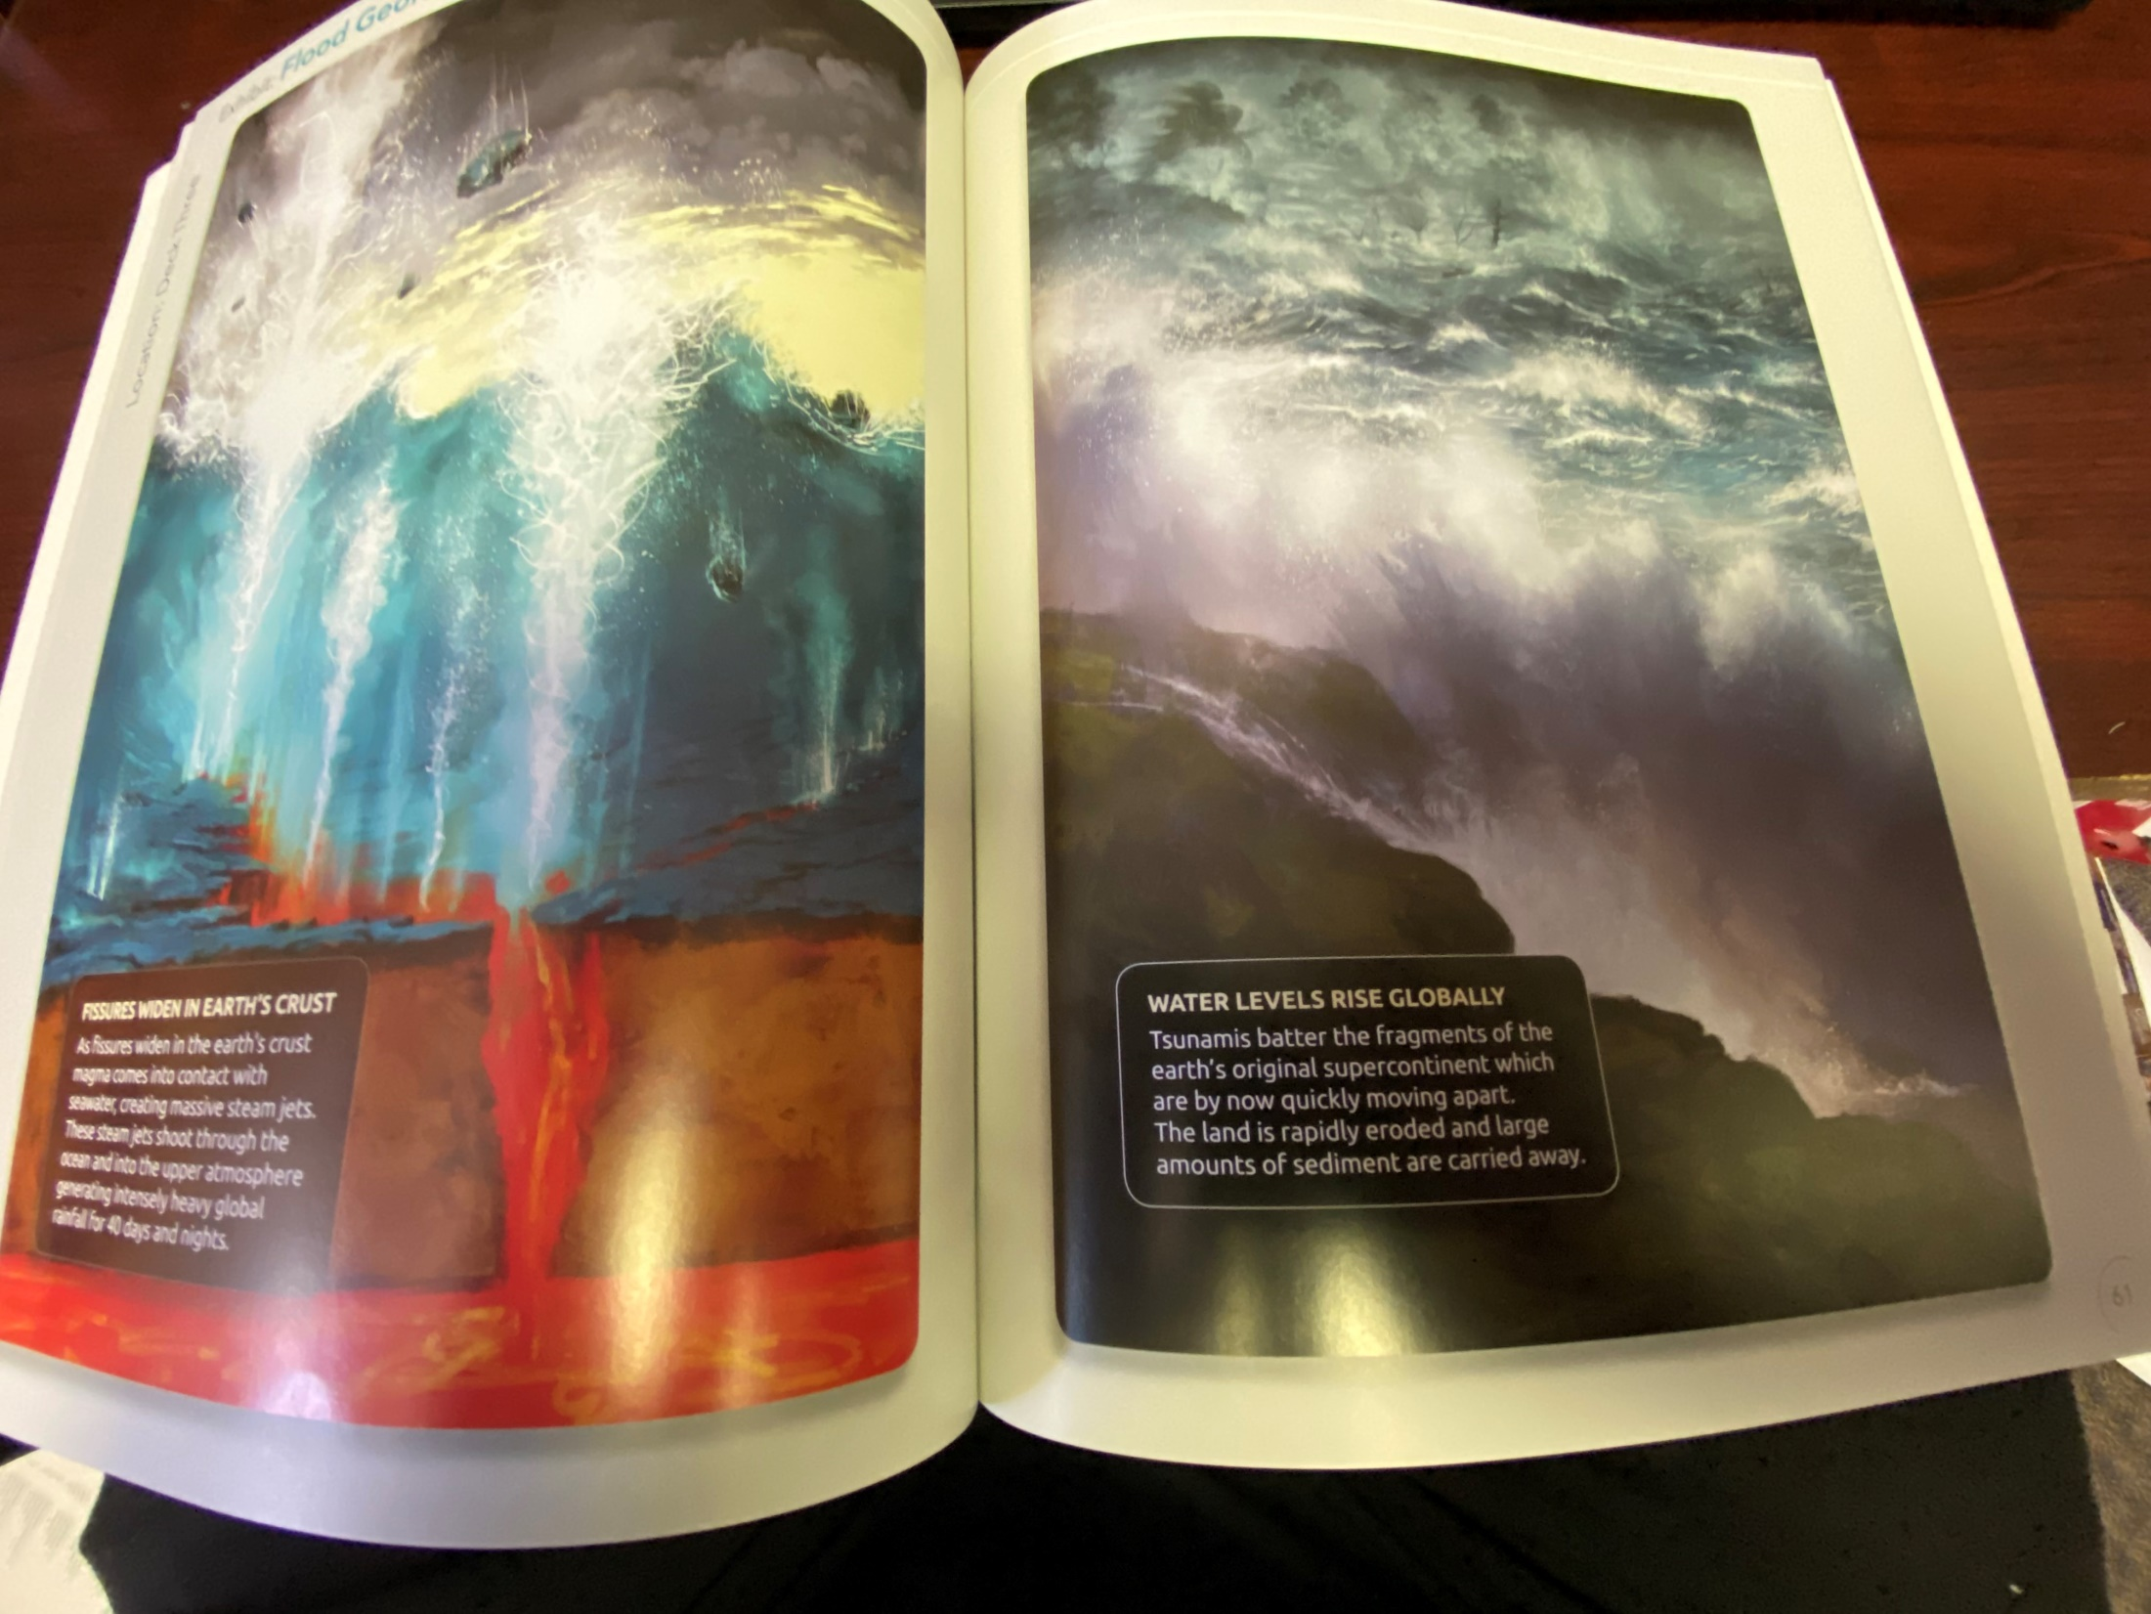

Slide 80
An excerpt from the website Christiananswers.net
“So, the “fountains of the great deep” are probably oceanic or possibly subterranean sources of water. In the context of the flood account, it could mean both. If the fountains of the great deep were the major source of the waters, then they must have been a huge source of water. Some have suggested that when God made the dry land appear from under the waters on the third day of creation, some of the water that covered the earth became trapped underneath and within the dry land.[2]
Genesis 7:11 says that on the day the flood began, there was a “breaking up” of the fountains, which implies a release of the water, possibly through large fissures in the ground or in the sea floor. The waters that had been held back burst forth with catastrophic consequences.
There are many volcanic rocks interspersed between the fossil layers in the rock record—layers that were obviously deposited during Noah's flood. So it is quite plausible that these fountains of the great deep involved a series of volcanic eruptions with prodigious amounts of water bursting up through the ground. It is interesting that up to 70 percent or more of what comes out of volcanoes today is water, often in the form of steam.”

Slide 81
Biblical Creationists argue that the theory of Pangea-the theory that the land of our earth was once all together can be explained by this breaking up due to the Flood. They argue that the land would have quickly moved apart from this break up, leading to continental divides we have today. This of course formed mountains and valleys relatively quickly.

Slide 82
The theory of the existence of a supercontinent they called Pangea was 1st theorized by a man named Alfred Wegener in 1912. Geography seems to support this. There are matching geological trends between the eastern coast of South America and the western coast of Africa. In addition, they say there is evidence in the fossil records. Excerpt from Wikipedia
“Fossil evidence for Pangaea includes the presence of similar and identical species on continents that are now great distances apart. For example, fossils of the therapsid Lystrosaurus have been found in South Africa, India and Antarctica, alongside members of the Glossopteris flora, whose distribution would have ranged from the polar circle to the equator if the continents had been in their present position; similarly, the freshwater reptile Mesosaurus has been found in only localized regions of the coasts of Brazil and West Africa.[20]”

Slide 83
Another excerpt from Wikipedia
“Paleomagnetic study of apparent polar wandering paths also support the theory of a supercontinent. Geologists can determine the movement of continental plates by examining the orientation of magnetic minerals in rocks; when rocks are formed, they take on the magnetic properties of the Earth and indicate in which direction the poles lie relative to the rock. Since the magnetic poles drift about the rotational pole with a period of only a few thousand years, measurements from numerous lavas spanning several thousand years are averaged to give an apparent mean polar position. Samples of sedimentary rock and intrusive igneous rock have magnetic orientations that are typically an average of the "secular variation" in the orientation of magnetic north because their remanent magnetizations are not acquired instantaneously. Magnetic differences between sample groups whose age varies by millions of years is due to a combination of true polar wander and the drifting of continents. The true polar wander component is identical for all samples, and can be removed, leaving geologists with the portion of this motion that shows continental drift and can be used to help reconstruct earlier continental positions.[21]
The continuity of mountain chains provides further evidence for Pangaea. One example of this is the Appalachian Mountains chain, which extends from the southeastern United States to the Caledonides of Ireland, Britain, Greenland, and Scandinavia.[22]”

Slide 84
We have modern day examples of great localized floods or volcanoes that did a significant amount of geological change and movement in a short amount of time. Mount St. Helens is a modern day example.

Slide 85
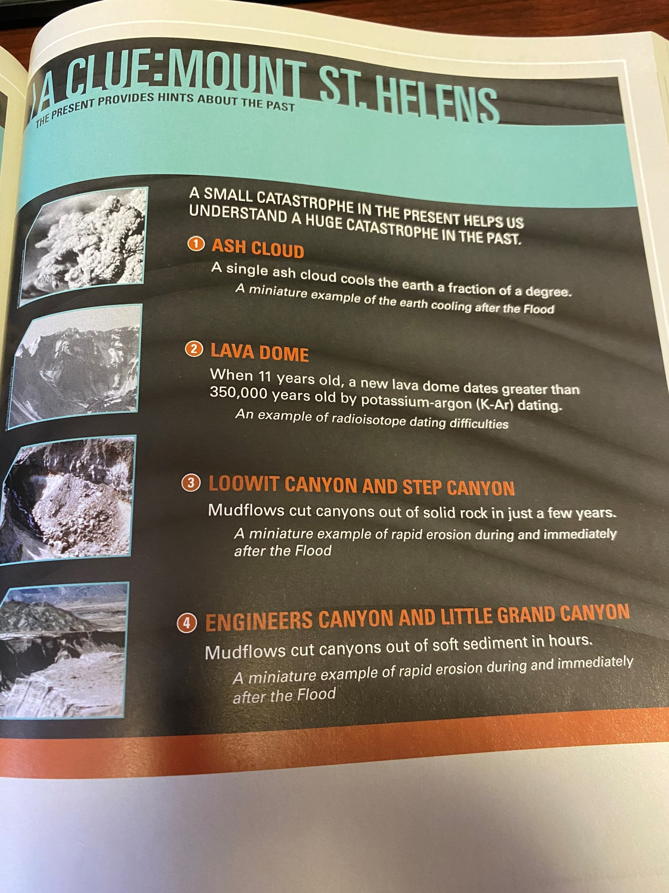

Slide 86
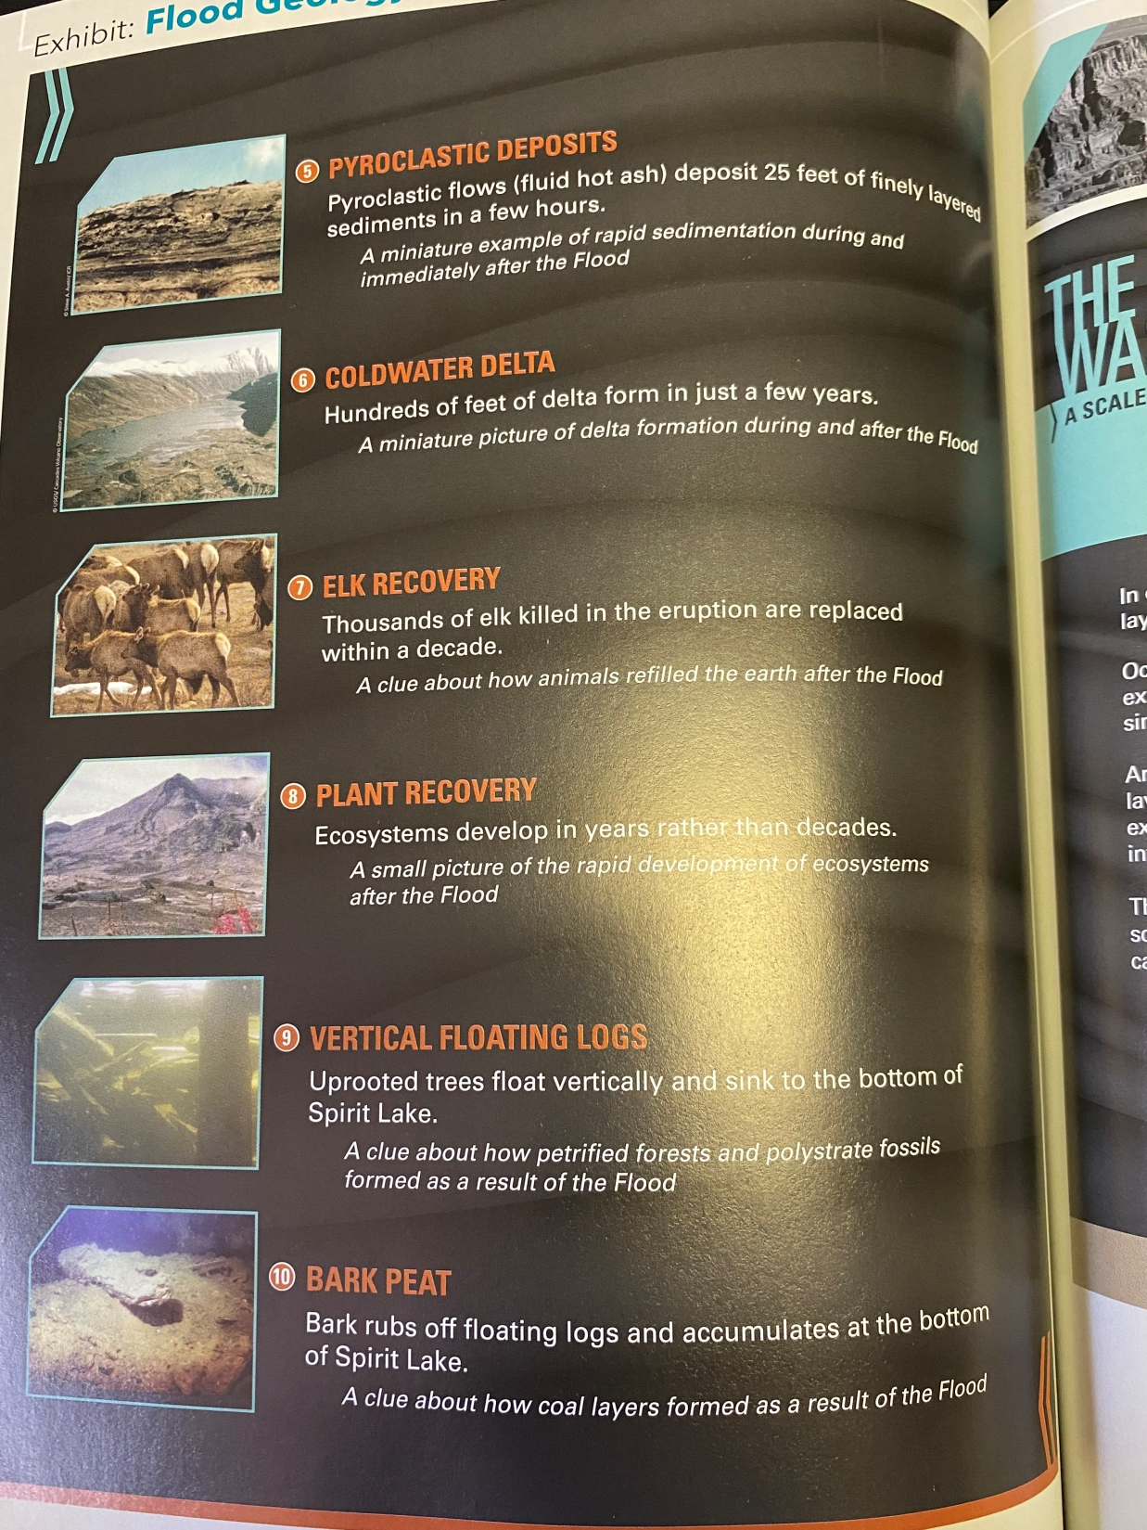

Slide 87
v. 11-(also) literally in the Hebrew “the window” of the heavens were opened.
Could be translated “window or chimney”-like Hosea 13:3. The windows of heaven are mentioned a couple other times in the OT too.
Malachi 3:10, Isaiah 24:18.
Therefore, not only was water coming from below causing the things described, it was also raining from above. Just think about a really hard 2 to 4 inch rain and how much damage and moving can be caused by that. Then multiply that by thousands of inches over 40 days and nights. We cannot grasp the amount of upheaval and changing this would cause to the landscape of our world.

Slide 88
Also, think about all the animals and humans buried in a very short amount of time in mud and under rock. This provides another evidence for a world wide flood. Marine life fossils are found on mountains or at high elevations, like the Himalayas. Spots can be found where many animals seem to be buried together.

Slide 89
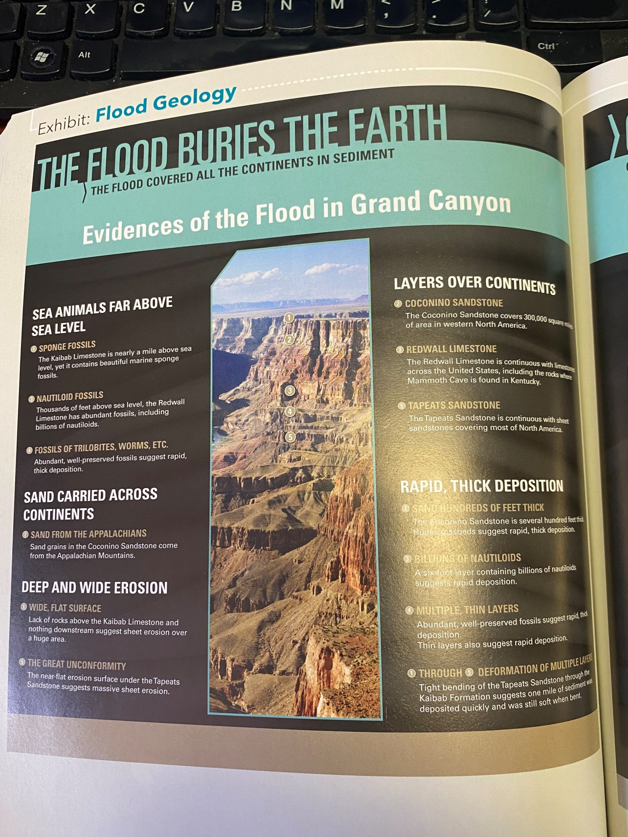

Slide 90
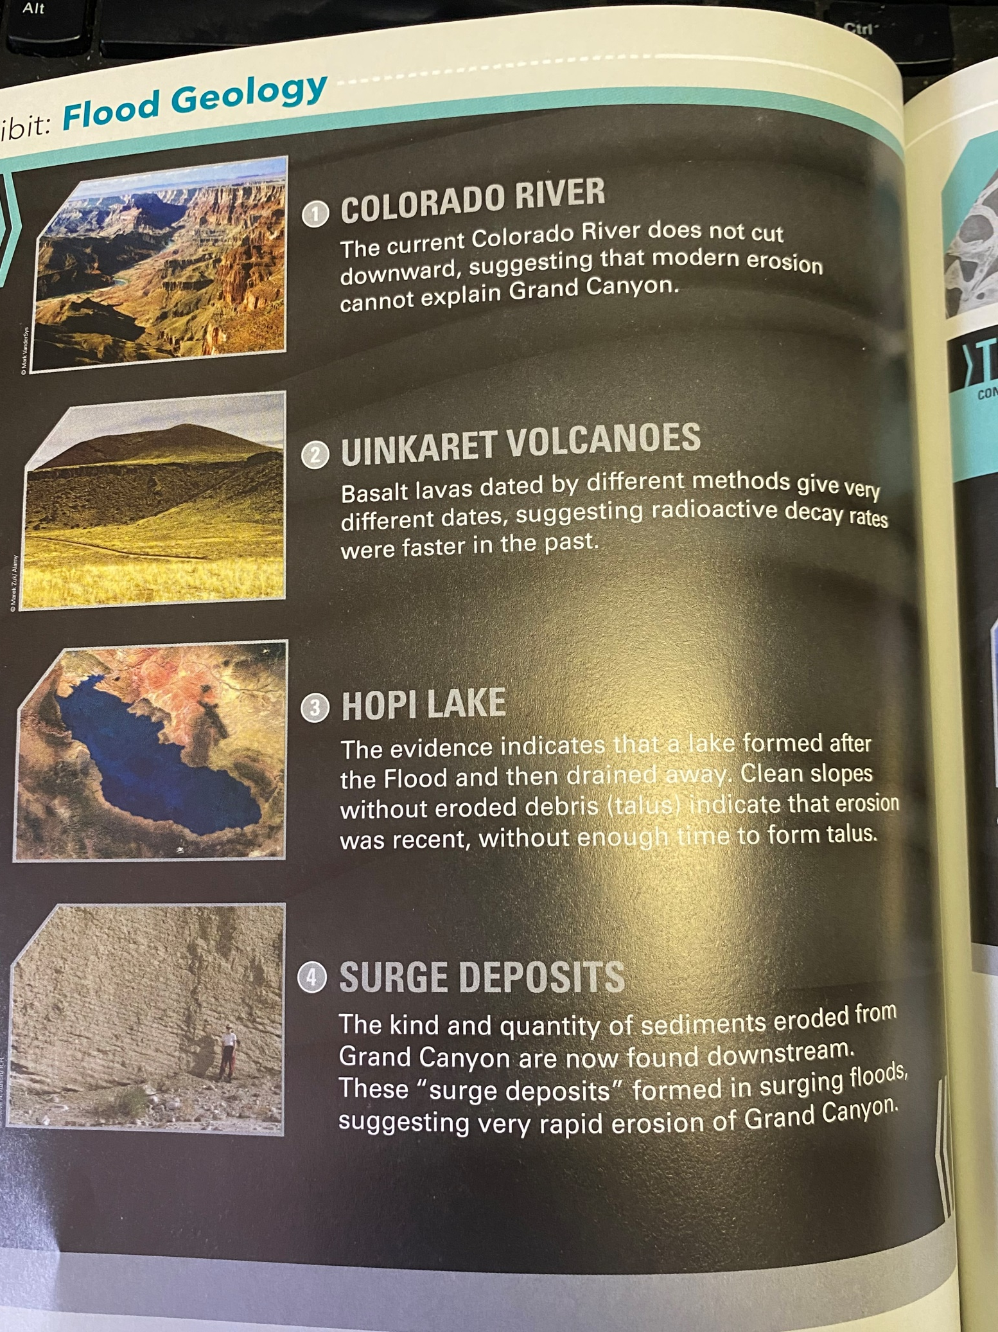

Slide 91
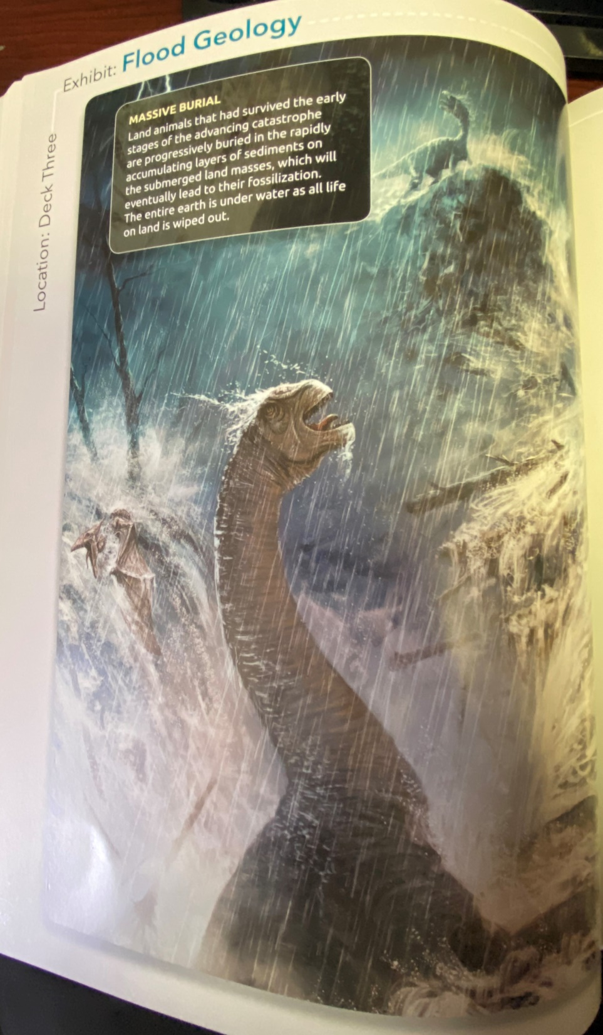

Slide 92
Except from Answers in Genesis article entitled, “Flood Evidence Number One: High and Dry Sea Creatures.”
“Marine fossils are also found high in the Himalayas, the world’s tallest mountain range, reaching up to 29,029 feet (8,848 m) above sea level.3 For example, fossil ammonites (coiled marine cephalopods) are found in limestone beds in the Himalayas of Nepal. All geologists agree that ocean waters must have buried these marine fossils in these limestone beds. So how did these marine limestone beds get high up in the Himalayas?”

Slide 93
Except from Answers in Genesis article entitled, “Flood Evidence Number One: High and Dry Sea Creatures.”
“It is beyond dispute among geologists that on every continent we find fossils of sea creatures in rock layers which today are high above sea level. For example, we find marine fossils in most of the rock layers in the Grand Canyon. This includes the topmost layer in the sequence, the Kaibab Limestone exposed at the rim of the canyon, which today is approximately 7,000–8,000 feet (2,130–2,440 m) above sea level.1 Though at the top of the sequence, this limestone must have been deposited beneath ocean waters loaded with lime sediment that swept over northern Arizona (and beyond).”

Slide 94
Interestingly, the explanation of secular scientists is that the animals were fossilized in a particular rock layer and then the mountains were pushed up over millions of years with those fossils present in them. Their explanation for the Grand Canyon is that the Colorado River has slowly cut away at the rock over these millions of years. The explanation for these sea creatures is that the top layer used to be the sea floor.

Slide 95
According to the National Park’s Service website, they would claim the youngest layers of rock are on the top.
“The story of how the Grand Canyon came to be begins with the formation of the layers and layers of rock that the canyon winds through. The story begins about 2 billion years ago when igneous and metamorphic rocks were formed. Then, layer upon layer of sedimentary rocks were laid on top of these basement rocks. To look at rock layers, geologists use a diagram called a stratigraphic column. It shows the rock layers with the oldest on the bottom, and the youngest on the top. That means that the bottom layer was formed first, and every subsequent layer was formed later, with the youngest rocks on the top.”

Slide 96
Further explanation from the National Park’s Service website.
The Uplift of the Colorado Plateau The Kaibab Limestone, the uppermost layer of rock at Grand Canyon, was formed at the bottom of the ocean. Yet today, at the top of the Colorado Plateau, the Kaibab Limestone is found at elevations up to 9,000 feet. How did these sea floor rocks attain such high elevations? Uplift of the Colorado Plateau was a key step in the eventual formation of Grand Canyon. The action of plate tectonics lifted the rocks high and flat, creating a plateau through which the Colorado River could cut down. The way in which the uplift of the Colorado Plateau occurred is puzzling. With uplift, geologists generally expect to see deformation of rocks. The rocks that comprise the Rocky Mountains, for example, were dramatically crunched and deformed during their uplift. On the Colorado Plateau, the rocks weren’t altered significantly; they were instead lifted high and flat. Just how and why uplift occurred this way is under investigation. While scientists don’t know exactly how the uplift of the Colorado Plateau occurred, a few hypotheses have been proposed. The two currently favored hypotheses call for something called shallow-angle subduction or continued uplift through isostacy.

Slide 97
Questions that need to be asked? 1. Where did the sea go if it used to be the sea floor? 2. What would have caused such a large uplifting? It cannot be explained like other mountains on continental divides. 3. Think about how large the Colorado had to have been if that is the sole explanation for the Canyon. It had to have been a huge lake size that slowly decreased to its present size. Where did all the water come from? Where did it go? 4. Some of the geology in the canyon goes against modern understanding of geology unless a massive, catastrophic flood event with lots of water happened. Articles in Answers in Genesis

Slide 98
There is also evidence in the fossil records of animals being fossilized very quickly. Such as a sea creature called a icthyosaur, discovered fossilized while giving birth to its young or a fish fossilized while eating another fish. Look at picture on the next slide.

Slide 100
v. 12-rain fell upon the earth for 40 days and nights.
v. 13-16-The text seems to read that on the day when it first started raining that Noah and the animals entered the Ark. They probably didn’t want to have to be in there any longer than they had too. Does it mean that the Lord let them know it was the day before the rains came that day or did they start entering the ark at the first sign of rain? We can’t know. You would think the process would require more time than when the rain first started coming.
The Lord closed the door. He was saving his creation.

Slide 101
v. 17-24-literally, “the waters multiplied”.
15 cubits above the highest point on earth-This would be roughly 22.5 feet.
They prevailed for 150 days in this way-5 months.

Slide 102
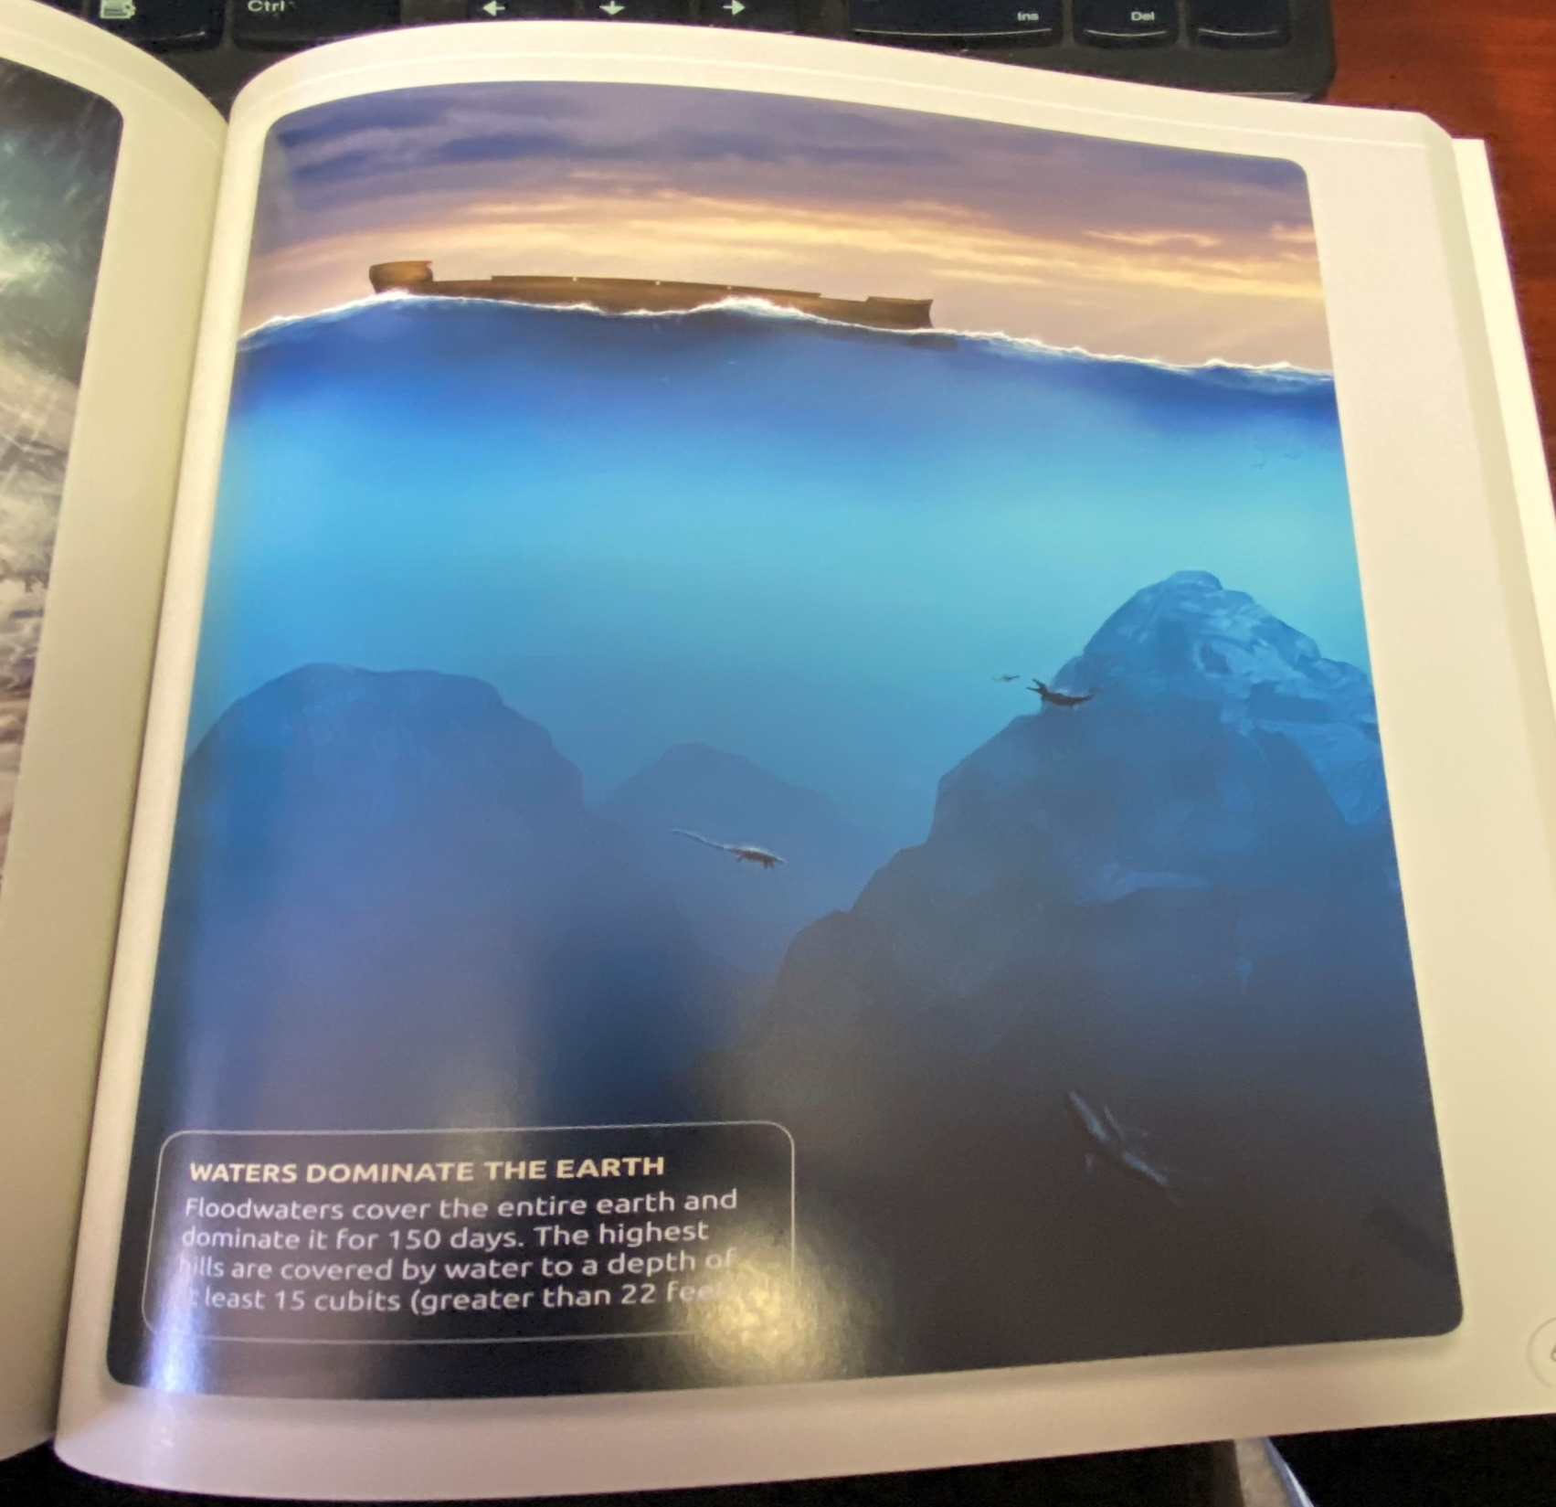

Slide 103
Chapter 8
v. 1-God remembered-This begins an interesting use of this Hebrew word in the Old Testament.
Many important times this word is used-Abraham after the destruction of Sodom (Gen.19:29), Rachel (30:22), his covenant (9:15-16). When God remembers, He acts, i.e. saving Lot, giving Rachel children, bringing Israel out of slavery (Ex. 2:24, 6:5). The word is more equivalent to “think about” than to the concept of recall. This is the first time God is said to have remembered someone and this passage is a paradigm of what that means in practice-Wenham p. 184

Slide 104
Lutheran Study Bible text note- “Describes God’s intention to act kindly. When God remembers his people, he does so “for good” (Nehemiah 5:19, 13:31.).
He made a wind to blow over the earth. Hebrew word Ruach-for Spirit, or wind or breath.
God’s Spirit is behind the wind-Same as Exodus 14:21-Red Sea, Same as Ezek. 37:9, Jonah 1:4.
Pentecost-Acts 2, John 3:8,
The Lord starts moving the waters into their proper places.

Slide 105
Imagine how this would move water rapidly and cause great erosion and destruction just in itself.
v. 2-It seems to say that the foundation or springs of the great deep and windows of heaven were closed after the 40 days while the wind then began to recede the waters. This once again would have caused great changes to the landscape and the world. Then God stopped them and kept back or restrained the rains.
v. 3-The waters receded continually for 5 months. The 150 days in 7:24 must be the same 150 days listed in 8:3.

Slide 106
v. 4-5 gives us the exact reference of 5 months after the flood started, the ark came to rest on the mountains of Ararat. Compare with 7:11. Roughly 2 ½ months later the tops of the mountains are seen.
There are stories of the Ark being witnessed on Mt. Ararat. Flood book-p. 77.
Video.

Slide 107
Where are the “mountains of Ararat?”
The Hebrew word is in the plural, so it is naming a mountain range, not necessarily a specific mountain. From the “Flood of Evidence” Book,
“The mountains of Ararat form a mountain range named after the Uratu people who settled in the region after the dispersion event at the Tower of Babel. In Hebrew, Ararat and Uratu are even spelled the same….Josephus, a Jewish historian living about 2,000 years ago, said that Armenia was made up of descendents of Hul through Aram and Shem. Armenia is the later name of the region of Uratu or Ararat….References to the land of Ararat are found in Isaiah 37:38 and Jeremiah 51:27. This ancient region is basically in the eastern part of modern-day Turkey, Armenia, and western Iran.”p. 266

Slide 108
So which mountain? Evidently, there has been some debate on this over of the years. Some argue the modern day Mt. Ararat in Turkey is the place. Part of the reason for this is because it says in the text, that the ark came to rest on the 17th day of the 7th month after the flood waters began. It says the tops of the mountains did not become visible until the 1st day of the 10th month, roughly 2 ½ months later. The argument is that the boat must have landed at the highest point in the region, sitting there for a time until the rock below could be seen.

Slide 109
They say the logical choice by these details would be Mt. Ararat, which is much taller than the mountains surrounding it. According to the book, “Flood of Evidence”, “Mt. Ararat is a large volcano that extends to a height of 16,854 feet. This is higher than any of the mountains in the 48 contiguous United States. Lesser Ararat is another volcano that stands adjacent to Mt. Ararat and is 12,782 ft….This is one reason some scholars argue that Mt. Ararat is the resting place for the ark.”-p. 268.

Slide 110
Another reason is because of eyewitness accounts of the boat in recent times. A man by the name of BJ Corbin wrote a book called “The Explorers of Ararat” in 1999 which I guess has some of these eyewitness accounts.
Read p. 268.
In the book, “The Flood” written in 1951, it has one of these accounts. A Russian aviator who supposedly saw what looked like a very large boat over Mt. Ararat.”

Slide 111
He said he and a buddy were testing a new Russian plane with a super charger installed and was ready for high altitude tests. He was stationed 25 miles from there. When flying over Mt. Ararat they spotted something. They said, “a submarine? No, it wasn’t because it had stubby masts. Read p. 79”. To be honest, it almost seems too well-written, but the story is out there. –Watch video

Slide 112
Some however object to Mt. Ararat being the place because it was so high in elevation. How did the animals get off the mountain? How would Noah and his family deal with the lack of oxygen? A major argument is that Mt. Ararat is a volcano, in which the uppermost rocks are volcanic. There is also very little fossil evidence on Mt. Ararat. They then argue that Mt. Ararat must have had an eruption after the Flood and therefore, was not as high as it is now.

Slide 113
Another place proposed is Mt. Cudi in the mountain range of Ararat. There are many ancient sources that claim that this was the place for the landing of the Ark. There are many legends associated with this location. It is therefore impossible to know, but stories are out there claiming to have witnessed the ark.

Slide 114
8:6-12
It seems to read after the boat had landed, 40 days later, Noah opens the window of the ark.
This would imply that Noah did have openings built into the top of the ark for lighting or to provide oxygen. He probably figured it was now safe to open up these windows to release the raven.
This Hebrew word of window is used in Joshua 2:15ff describing the opening in the wall that Rahab escaped through fleeing Jericho.

Slide 115
Wenham, “Apparently, the window must have been in the roof of the ark; at least it did not allow Noah to see the waters receding, which is why he resorts to sending out the birds. Gispen notes that before the electronic era sailors used to use birds in this way to discover if land was close.”-p. 186

Slide 116
Why a raven? Ravens were scavenger birds. They would fly searching for dry land. They would settle when they found enough to eat.
According to one website I was checking out, it talks about how intelligent ravens are. They can imitate human speech, in some cases better than parrots.
“Evolutionarily speaking, the deck is stacked in the raven’s favor. They can live in a variety of habitats, from snow to desert to mountains to forests. They are scavengers with a varied diet that includes fish, meat, seeds, fruit, carrion, and garbage. They are not above tricking animals out of their food—one raven will distract the other animal, for example, and the other will steal its food.”-From the website mentalfloss.com

Slide 117
v. 8-12-Doves however are more finicky.
According to the website, birdsandblooms.com,
Doves are primarily seed eaters and not insect eaters. Therefore, they could not settle until trees had grown enough on the land to produce seeds to eat. Doves are also known for their homing instincts. Doves or pigeons were used throughout history to send messages during wartime or other times. Interesting facts.
Regardless of how Pigeons find their way home, their ability to find their way home is nothing short of incredible.
In the late 1800s, the most heroic recorded flight was from a pigeon released in Africa that took 55 days to get home to England. Travelling over a staggering 11,000 kilometres!
Pigeons can fly at altitudes of 6000 feet at an average speed of 77.6 miles per hour.
The fastest recorded speed for a pigeon is 92.5 miles per hour.-From the website dovesoflove.com

Slide 118
Therefore, for many reasons, the dove was the choice to see whether it was safe to leave the ark or not because the flood waters had receded enough to allow habitation of the land.

Slide 119
Read 8:13-19-In the 601st year, in the first month, the first day of the month.
Upon Noah’s 601st birthday, if I am reading this right, Moses reports that the land is finally dried off enough for man to live on it again. What a birthday gift, if I am reading this right.
Covering-Used in OT for the covering over the tent of meeting-Ex. 26:14, 36:19. 39:34.
Show picture in Luth. Study Bible p. 139.
Therefore, the roof or covering that kept the water out during the flood.

Slide 120
Noah finally felt comfortable that the rain had stopped and he could take off the covering and look for himself to see if the land was habitable. The dove had given him that hope, but now he sees it for himself.
It says, “And he saw and behold!”
v.14-Now a year and ten days later, the earth had fully dried from the flood and was not habitable. Although, I have read arguments that based on ancient calendars, it could be that it was exactly a year because the assumption is made that they were counting months in those days only by 30 days. This would bring it to 370 days.

Slide 121
Regardless, almost exactly a year later, God tells Noah and his family that they can finally leave the ark. Notice there is no mention of Noah’s sons having children at this point.
It was asked last week about how old Noah’s sons were. We are told in Gen. 5:32 that “After Noah was 500 years old, Noah fathered Shem, Ham, and Japheth.” This would make them no more than 100 years old. Now why didn’t they have children yet? It could be because the Lord prevented them from having them and raising them in that wicked world or because they chose not to bring children into that world. God gives them the command here though to be fruitful and multiply, like he had said to Adam and Eve (Gen. 1:28).

Slide 122
Interestingly, we are told in v. 19 that when the animals went forth from the ark, they went forth “by families or clans.” This could just mean by species or by similar kinds of animals, but it also could imply that the animals were already having babies and left the ark with them. Hebrew word used later for family groups-Gen. 10:5, 10:20, 32, 12:3.
The word usually means “a sub-unit of a larger tribe, consisting of a number of extended families.”

Slide 123
Read v. 20-22-”Noah built an altar”-1st time this Hebrew word for “altar” is used in OT. It sets the precedent for future generations of how to respond to God’s mercy and goodness: with sacrifice and worship.
It shows again why he was told to take extra of the clean animals.
He offered “burnt offerings”-God later gives instructions regarding these kinds of offerings in Leviticus 1. They were to be regularly done by the priests on behalf of the people after Israel becomes a nation and Moses receives the Law.

Slide 124
v. 21-The Lord “”smelled”-Interestingly, the root of this word is the three letter Hebrew root where you get “Ruach”, meaning Spirit, wind, or breath from.
I don’t know if there is any significance to this or not. But one wonders whether it could be that God was spirited or kind of moved in His Spirit by the pleasing aroma. It might be reading into this a bit bunch, but according to the Wenham commentary, this is only time the Lord is actually recorded as having “smelled” a sacrifice.

Slide 125
v. 21-He smelled the “soothing or pleasing aroma” and the Lord said in his heart.
He is moved to his heart or inmost being by this sacrifice.
Wenham- “For God to ‘smell’ a sacrifice implies his acceptance of it and the offerer.”-p. 189

Slide 126
Marin Luther has an interesting note on this verse, he says, “Actually the word does not mean ‘odor of pleasantness’, it means ‘odor of rest’. For the Hebrew word comes from the verb, which Moses used in Gen. 8:4, meaning ‘rest’, when he stated that the ark rested on the mountains of Ararat. Hence it is the odor of rest, because at that time God rested from wrath in that He gave up His wrath, was appeased, and, as we ordinarily say, was well pleased.”-p. 116-117-Lectures on Genesis

Slide 127
Wenham-””In the sacrificial law, this is a regular term for the smell produced by burning the sacrifices (Lev. 1:9, 2:2, 3:5). …That God’s anger at sin is appeased by sacrifice is the clear implication of this phrase.”-p. 189

Slide 128
Moses had mentioned the Lord’s “heart” before in Genesis 6:6. He was “grieved to his heart” at that time. Now His heart is moved to say, “I will never again curse the ground because of man, for the intention of man’s heart is evil from his youth. Neither will I ever again strike down every creature as I have done. While the earth remains, seedtime and harvest, cold and heat, summer and winter, day and night, shall not cease.”

Slide 129
v. 21- I will never curse”
This word for curse is not the word for curse found in Gen. 3:14, 17, 4:11, 5:29. Meaning to “inflict with a curse.” According to Wenham, this is a milder word in the Hebrew for curse.

Slide 130
“This shows that God is not lifting the curse on the ground pronounced in Gen. 3:17 for man’s disobedience, but promising not to add to it. The flood was a punishment over and above that decreed in 3:17. This is further confirmed by the milder word for ‘curse’, meaning, ‘to treat lightly, disdain’ used here as opposed to the graver term used in 3:17.”-Wenham-p. 190

Slide 131
If you think about it, the ground really did have to bear punishment along with man. It was completely wiped clean of life on the habitable land. It has never had to bear that kind of curse again. God’s creation groans under localized chaos due to earthquakes, fires, etc. However, all of life has never been wiped out like that since the Flood. This is what the Lord is promising here. Curse the ground, specifically the land, the Adama, Gen. 2:7.

Slide 132
The Lord knows man will always have this evil of sin residing in their hearts since youth (birth), so the world will go the way it did before the flood again and again. However, the Lord won’t let the land have to be “disdained or cursed” just because of man’s wickedness. He says the same about the animals.

Slide 133
v. 22- “While or again in all the days of the earth, what we know as seedtime and harvest, cold and heat, summer and winter, day and night will not cease.”
All production of God’s creation was stopped for a time under the flood waters. Now the Lord promises this will never happen again as long as the earth remains.
It is why on the last day, the Lord has to completely destroy the heavens and earth and make everything new. The old earth has to go away in order for a new to come because God will destroy the earth one day. Look at 2 Peter 3:1-7. Jesus said, “heaven and earth will pass away.”. Revelation 20:11

Slide 134
Chapter 9
9:1-The Lord gives the command to them to be fruitful and multiply and fill the earth.”
It is the Lord now giving Noah and his sons the command to be fruitful like he did Adam and Eve-Gen. 1:28. They were to spread out and fill God’s earth.

Slide 135
v.2-God puts fear and terror or dread into the animals that they would respect man and his role of dominion over them.
This was to perhaps protect man from these animals who make look at them as meat after the Flood because food will be scarcer and climates harsher. But also, it could be to protect the animals also from man. They will run when before they might not have ran because they were not eaten as food by man. Now God gives the command that man can also eat meat. As God said, “Into your hand, they are delivered or given.”

Slide 136
Lutheran study Bible text note-”People will have dominion to hunt or tame the animals.”
Why does the Lord now give the command that man can now eat the animals?
Lutheran Study Bible text note- “Humans will eat animals. The Lord enacts dietary rules, which Moses later repeated and amplifies (Lev. 11). The decreasing fruitfulness of the earth (3:17-19) perhaps made it necessary for the animals to serve this purpose. In extremely cold or arid regions, humans could not survive without animals for food.”-p. 28

Slide 137
It is where we do believe the results of the Flood dramatically changed the post-Flood world. It caused a change in climate that made the poles cold and the equator quite hot. The Creation Museum and Ark Encounter argue that the great ice age was caused by the post-Flood climate. Once again, where did all that water come from that is in the form of ice right now? It could also be the explanation for the extinction of some of the dinosaurs. They perhaps could not survive the post-Flood world or were hunted to extinction by man.

Slide 138
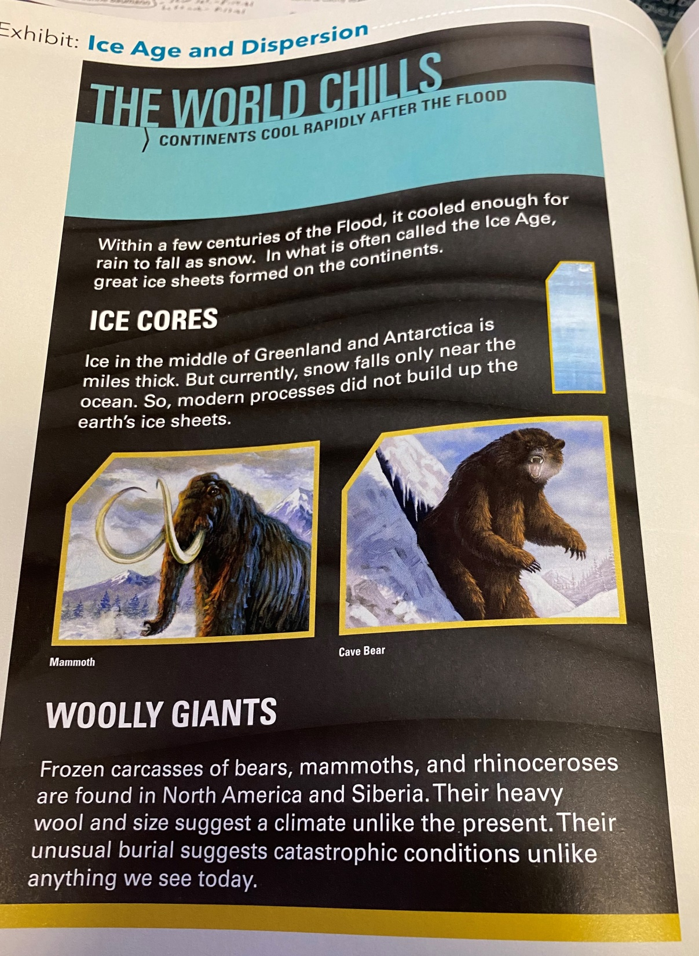

Slide 140
v. 4-You shall not eat flesh with its life, that is, its blood.
Why the blood?
Luth. Study Bible text note- “Blood was regarded as the seat and soul of life. God’s people were not to emulate the pagan practice of eating blood.”
The Lord repeats this kind of command in other places-Leviticus 17:10-12, 19:26, Deut. 15:23.
Also Leviticus 17:3-4. Life is precious to the Lord. All life. It is not to be taken except for a purpose of eating or for sacrifice. However, the blood is precious because it is the life of the animal or human. Therefore, it is to be treated as sacred in a way. The Lord accepts the blood sacrifice as atonement for the life of the other.

Slide 141
Read Leviticus Commentary p. 365-366
Excerpts- “The teaching of this chapter forbids all those ritual uses of blood. God reserved all blood for himself as the life-giver. It had to be given back to him….God did not establish the sanctity of animal life in Lev. 17:4, as some maintain. Rather God declared that he protected the life of domestic animals, even as he protected human life. He did not allow anyone to take the life of any animal unless he himself had sanctioned it (Gen. 9:3-4). Since he had not sanctioned the ritual slaughter of animals apart from the tabernacle, those who did so were guilty of bloodshed. He considered them to be murderers, for they had stolen life for themselves from the animal and so from God”

Slide 142
It is what we believe the Lord is saying in Gen. 9:5-6. He requires a reckoning.
Wenham- “No sins shows greater contempt for life than homicide. Whereas an animal’s blood may be shed but not consumed, human blood cannot even be shed. Three times God says he will require it, i.e., demand a reckoning “for your lives” (Ps. 9:13, Ezek. 33:6). A reckoning-a life for a life.”

Slide 144
v.6-This establishes the first concept of the law: a life for a life. Look at Leviticus 24:17-21, Exodus 21:12-14.
But why is God so angered by someone purposely taking the life of another?
He made them. They were made in his image. It is an offense to His very being because He gave that life and it is his to take away in time.

Slide 145
v. 7-Notice the Lord repeats a second time the command to now be fruitful and multiply. He says to teem or swarm the earth. It is another command to fan out and fill the earth.
Now why do you think this command is so important? When does it later matter?

Slide 146
Read v. 8-17
v.9-He uses the word “behold” again.
Establish a covenant with you-Only 2nd time in the Bible this word covenant is used. 1st in 6:18.
It is a Hebrew word that literally means, “to cut”.
He is establishing an agreement, a contract of sorts with Noah and his sons.
v. 11-He is now promising to never cut off all life on earth through a flood again of a universal scale. Read text note.

Slide 147
v. 13-I will set or establish my bow in the cloud-In other places, it is used for a weapon like a bow for an archer.
Interestingly, do you know where the bow shows us in another place of Scripture?
Look at Revelation 4:3. Greek word, “iris”, where you get the English word “iris” from.
Also in Revelation 10:1.

Slide 148
It was this sign to God that would bring to remembrance this covenant promise to Noah and His Sons and all future generations.
First mention of clouds in Gen. 9:13-15.
v. 16-The everlasting covenant between God and every living creature (living nephesh).
Signs-1st mentioned in 1:14.

